Slide 1

An NSS Audio-Visual
Library Presentation
The Best of the
1994 NSS Photo Salon
National Speleological Society
S917 81 Slides 3/08/2021

Slide 2
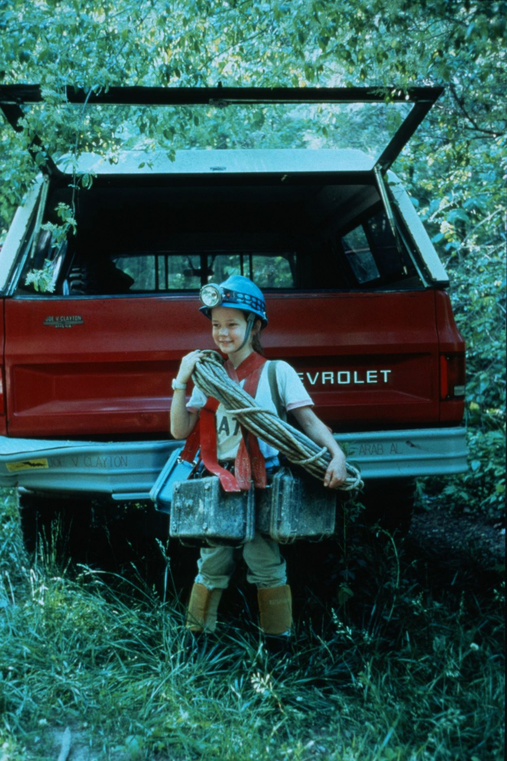
Notes:
My Favorite Photo Sherpa – John Van Swearingen, IV

Slide 3
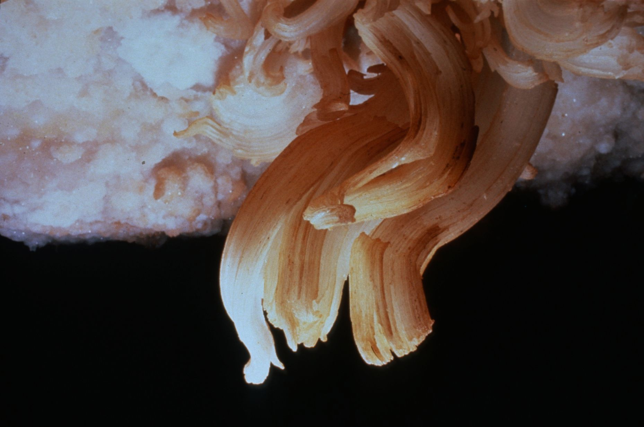
Notes:
Gypsum Flowers in Fitton – Jay Jordan

Slide 4
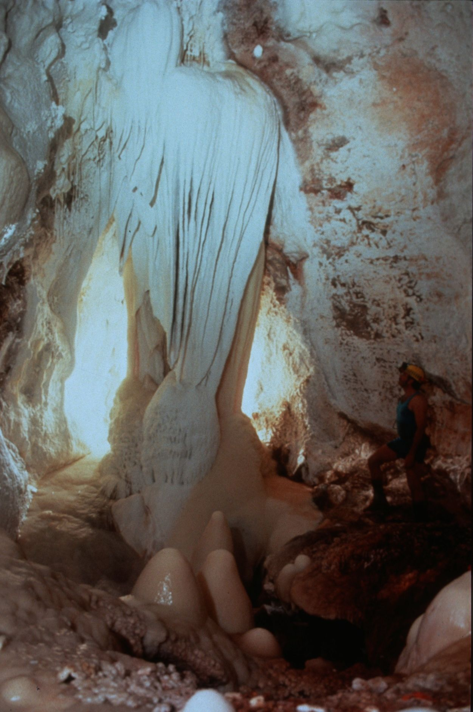
Notes:
Portal To Hidden Treasure – Robert Montgomery

Slide 5
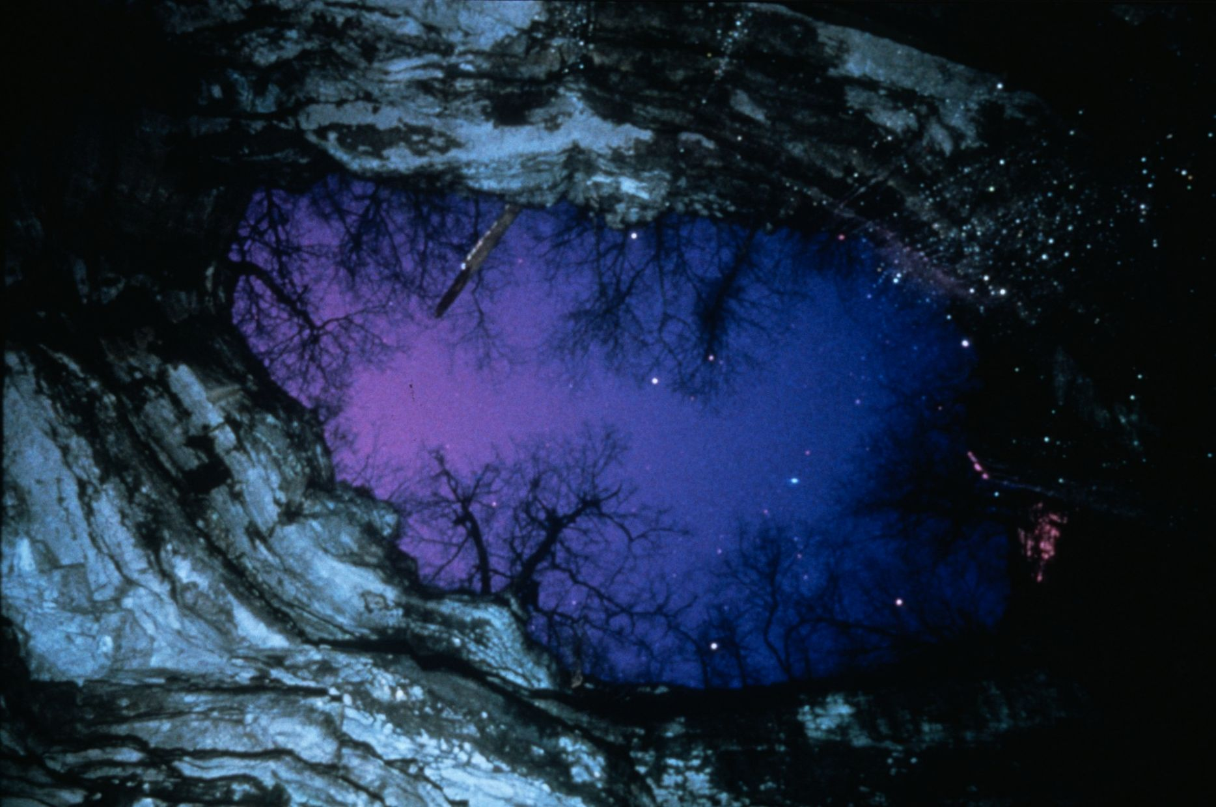
Notes:
Star Light, Star Bright – John Van Swearingen, IV

Slide 6
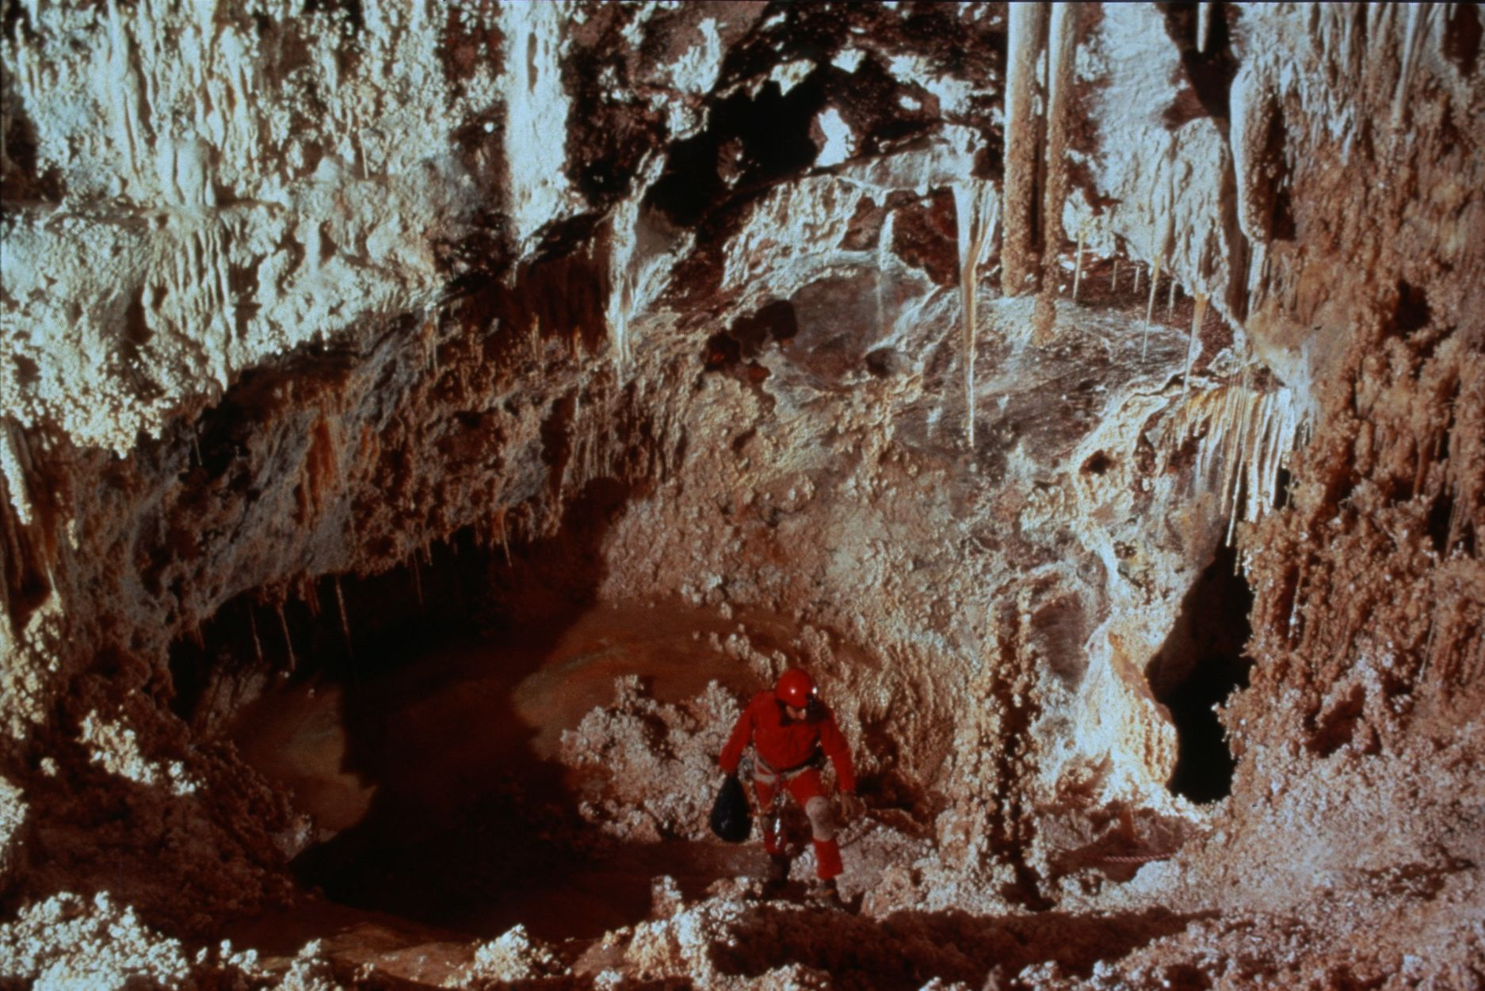
Notes:
Up-Slope – Dave Bunnell

Slide 7
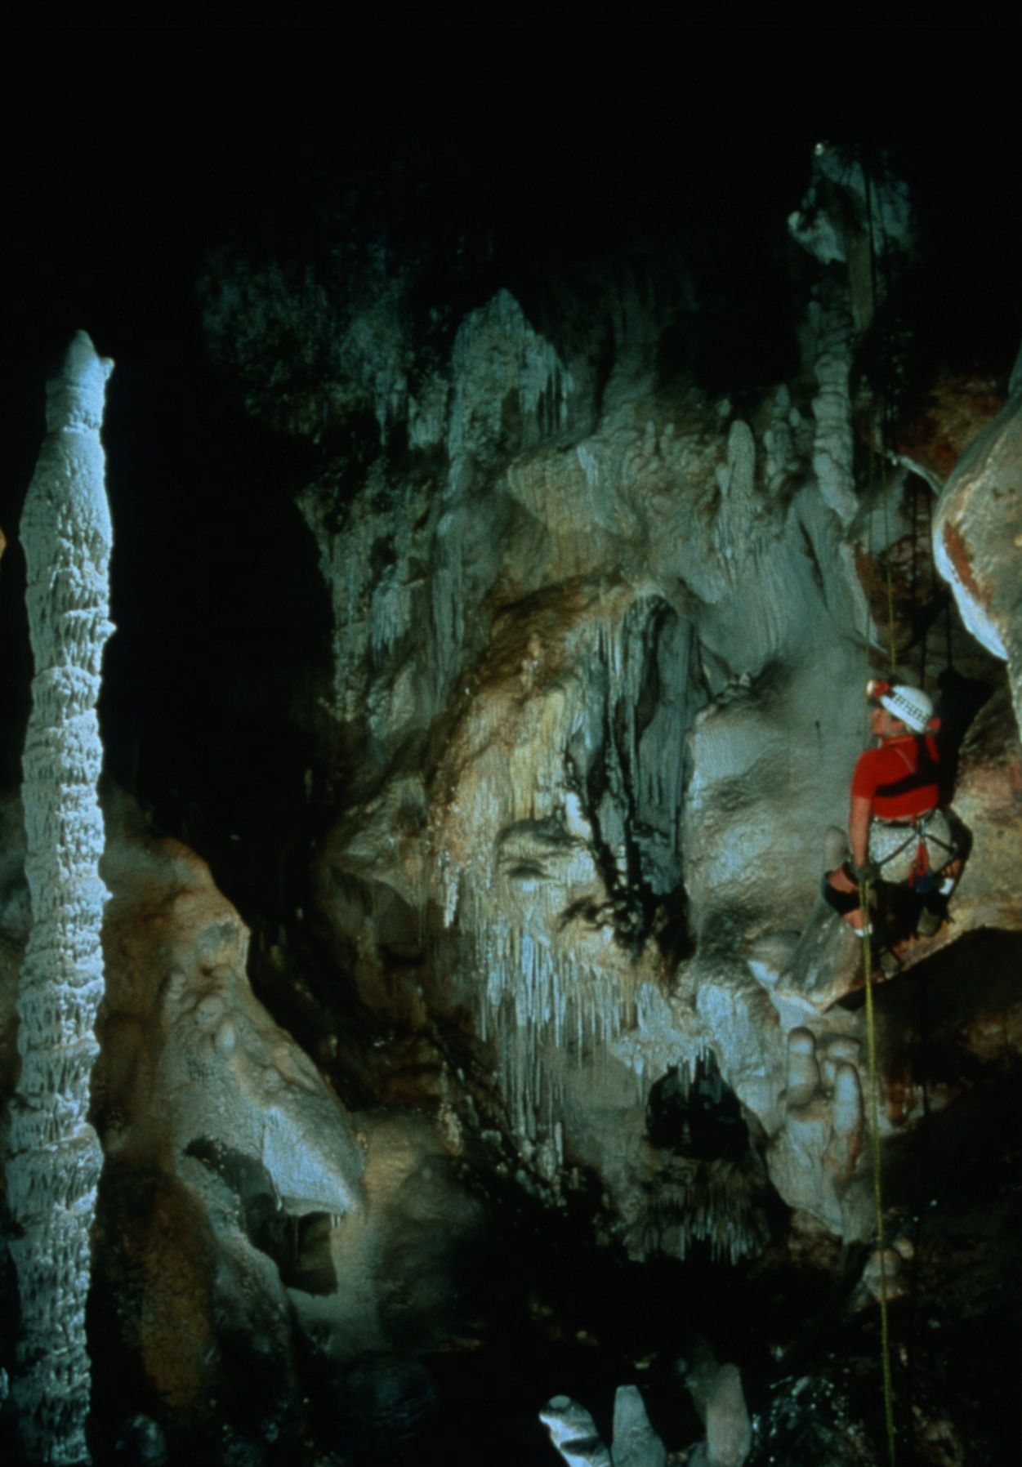
Notes:
Getting Off the Tourist Trail – David Harris

Slide 8
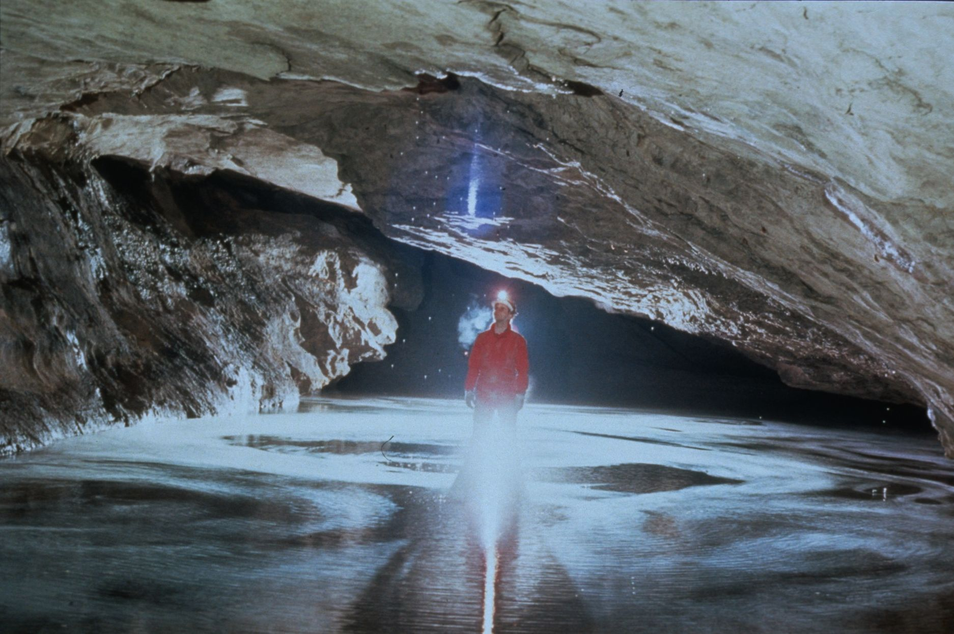
Notes:
Witches Brew – Ed McCarthy and Carl Samples

Slide 9
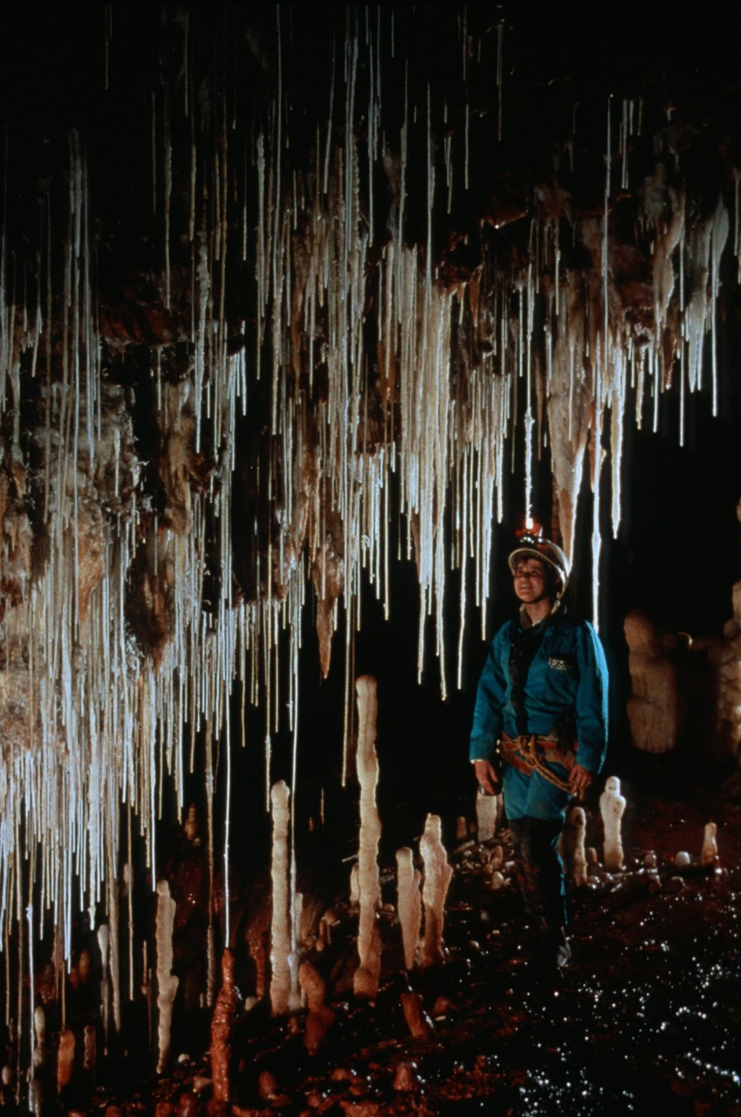
Notes:
The Long Look – Peter and Ann Bosted

Slide 10
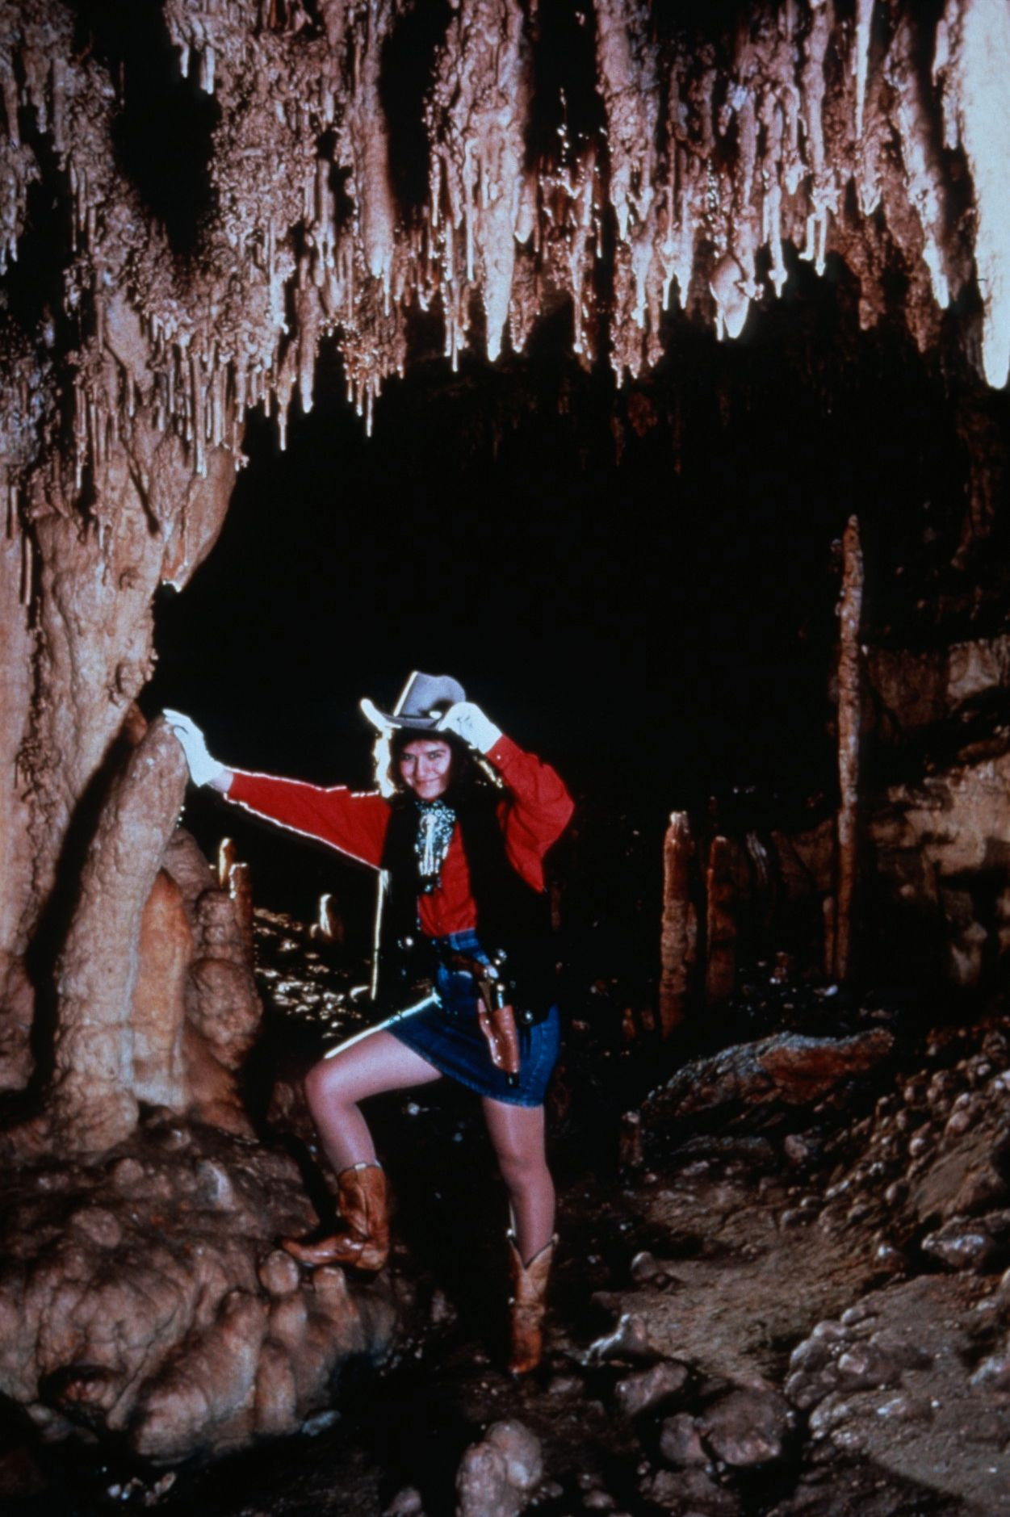
Notes:
Shoot Out at the O Kave Corral – John Van Swearingen, IV

Slide 11
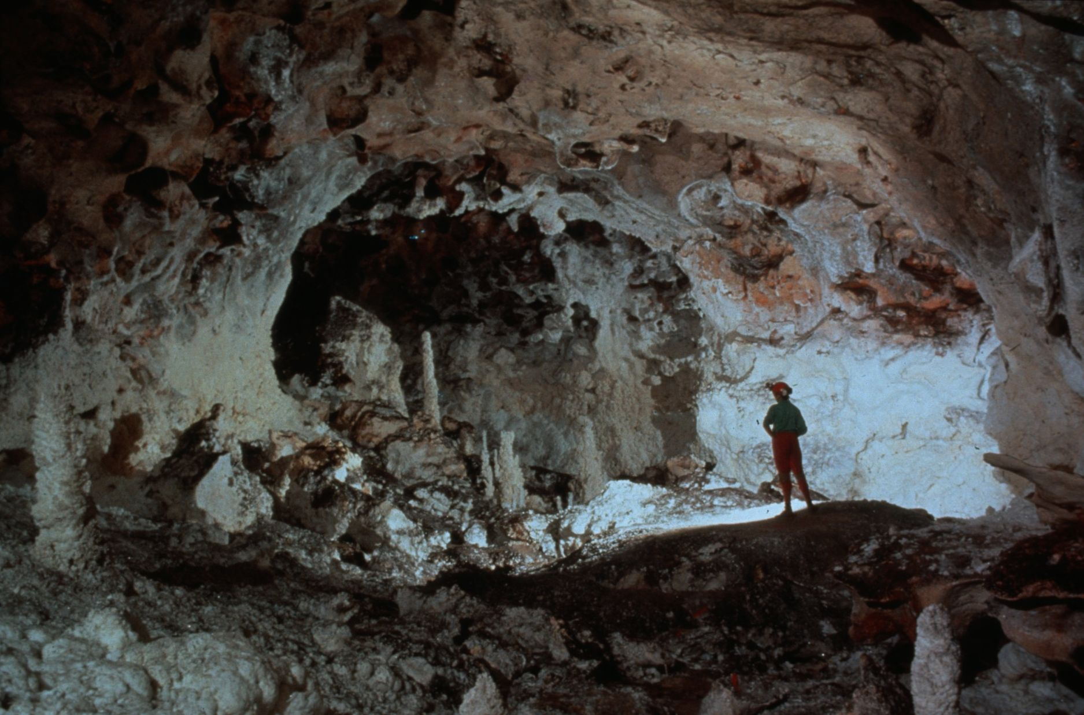
Notes:
Boneyard Borehole – Dave Bunnell and Djuna Bewley

Slide 12
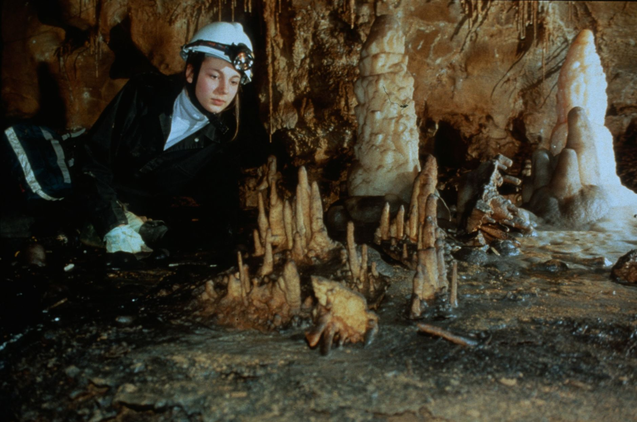
Notes:
Small Wonders – Collin Gatland

Slide 13
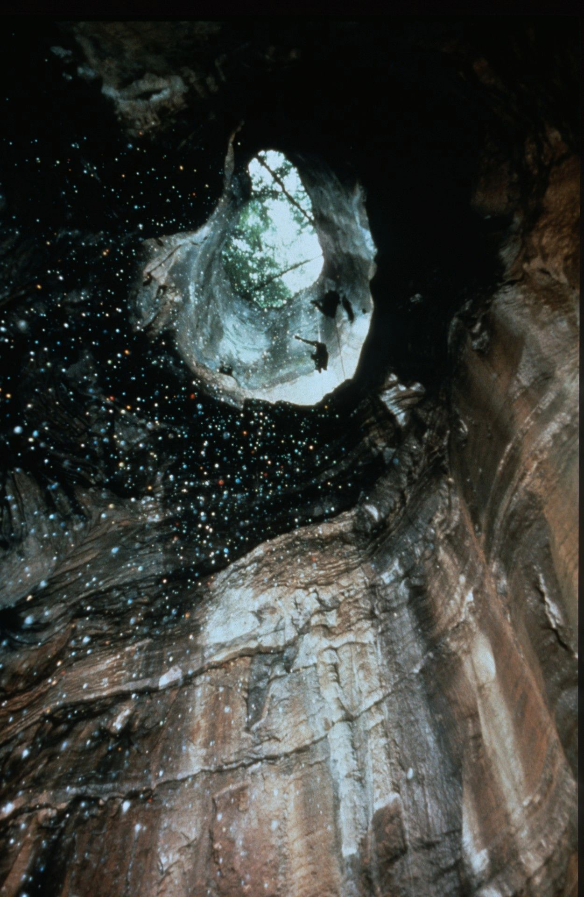
Notes:
Thunderstorm in Cagle’s Chasm - John Van Swearingen, IV

Slide 14
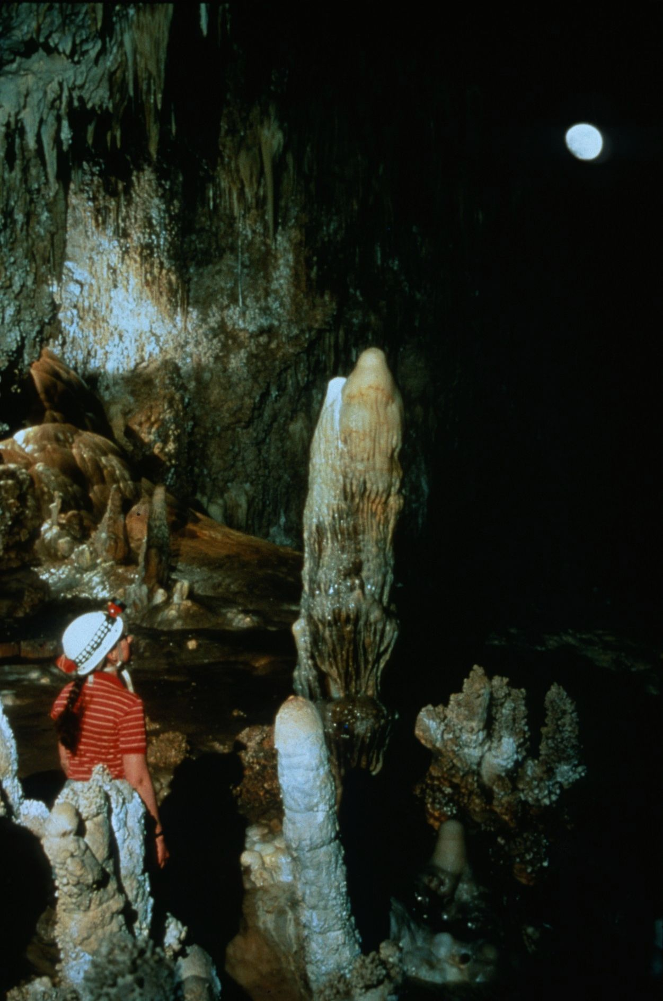
Notes:
Moon Under New Mexico – David Harris

Slide 15
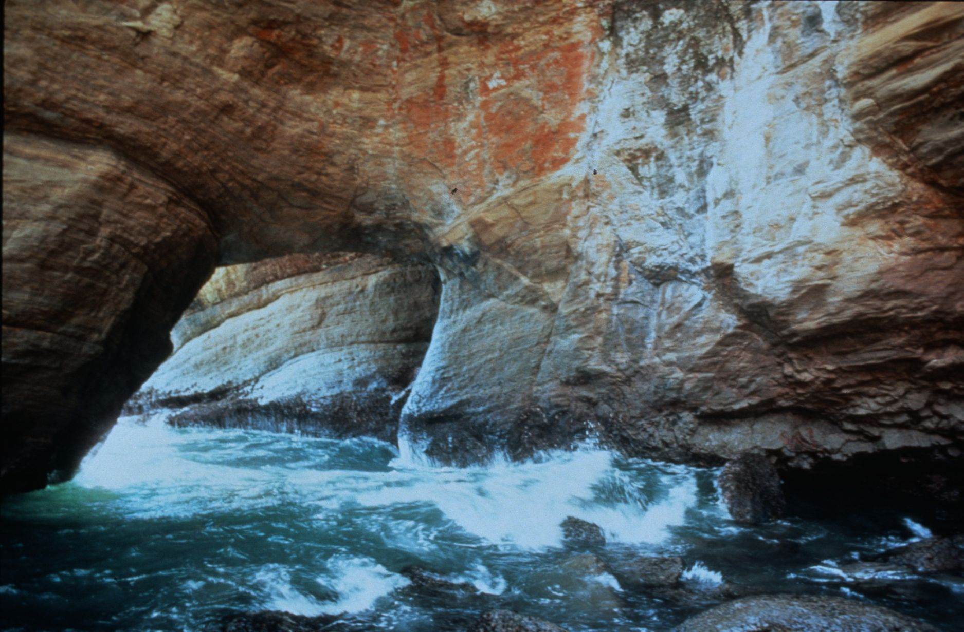
Notes:
The Devil’s Punch Bowl – Dave Bunnell

Slide 16
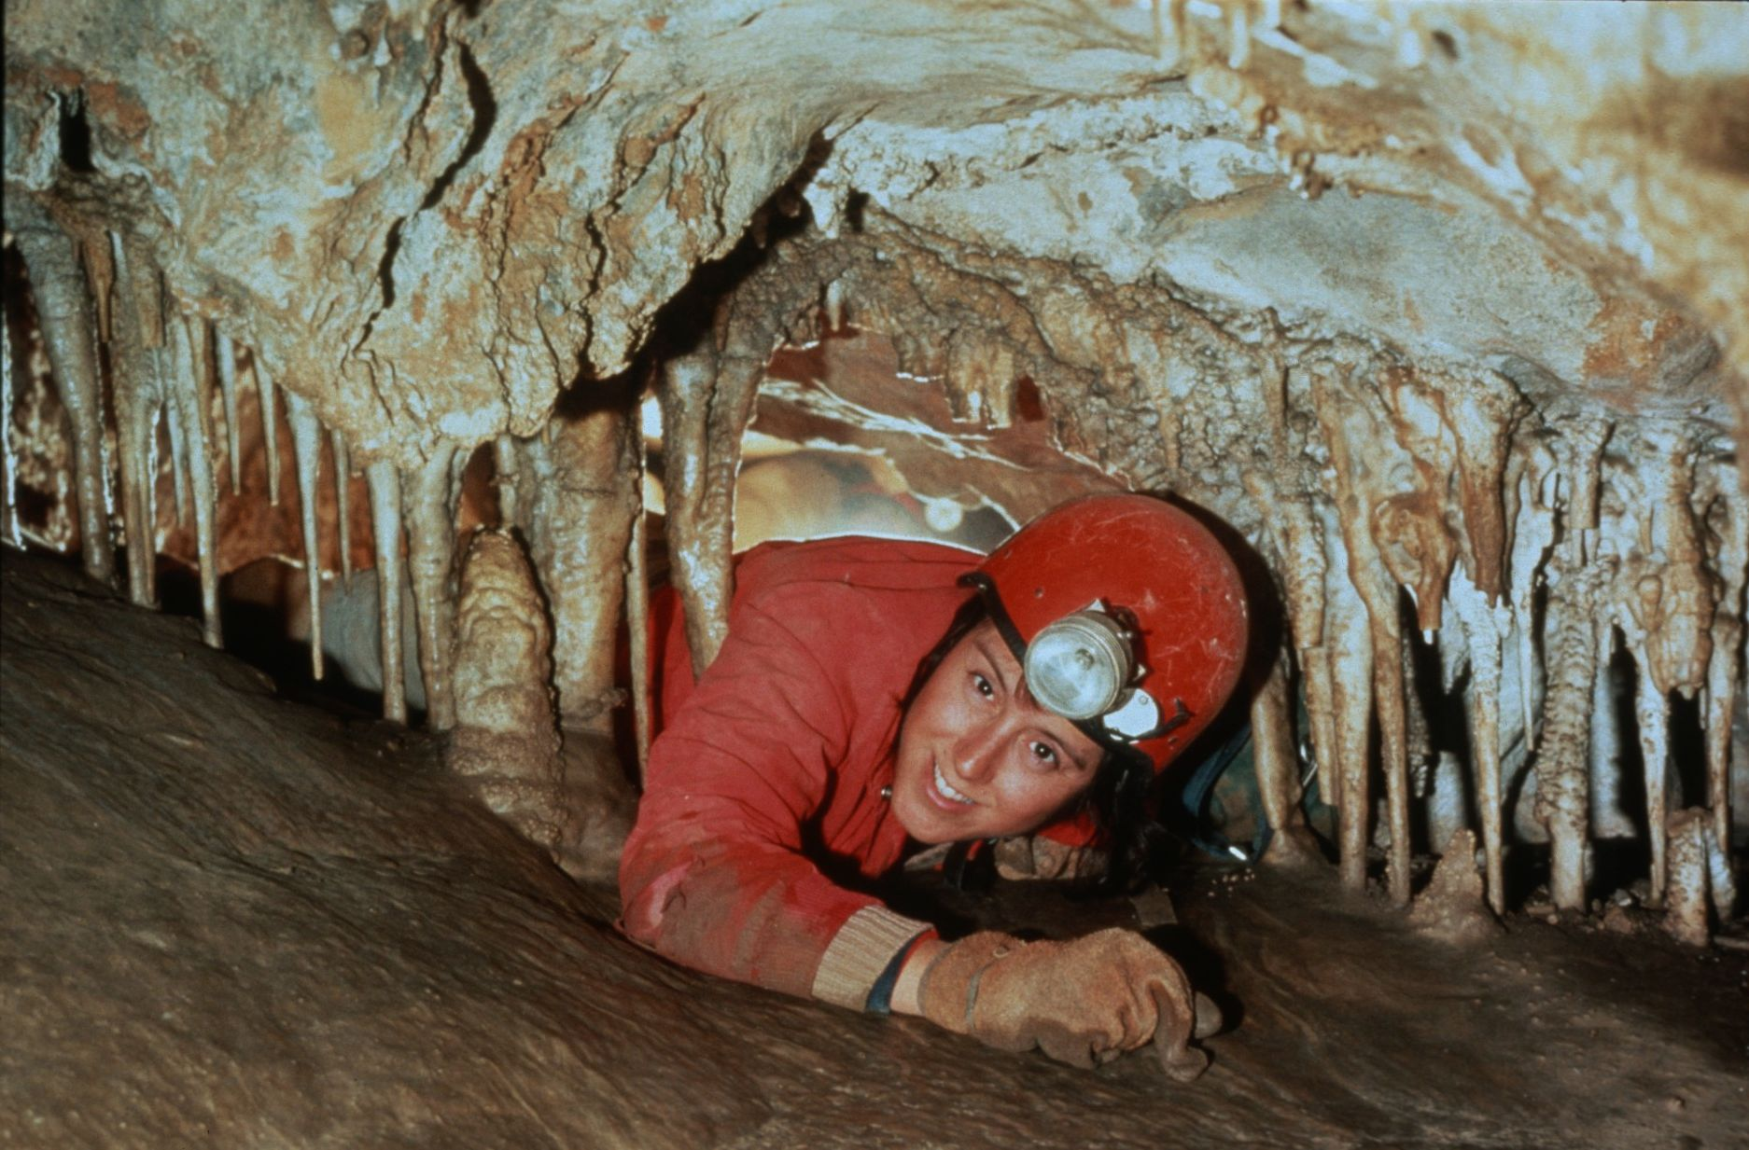
Notes:
Lisa in the Jail Break – Robert Montgomery

Slide 17
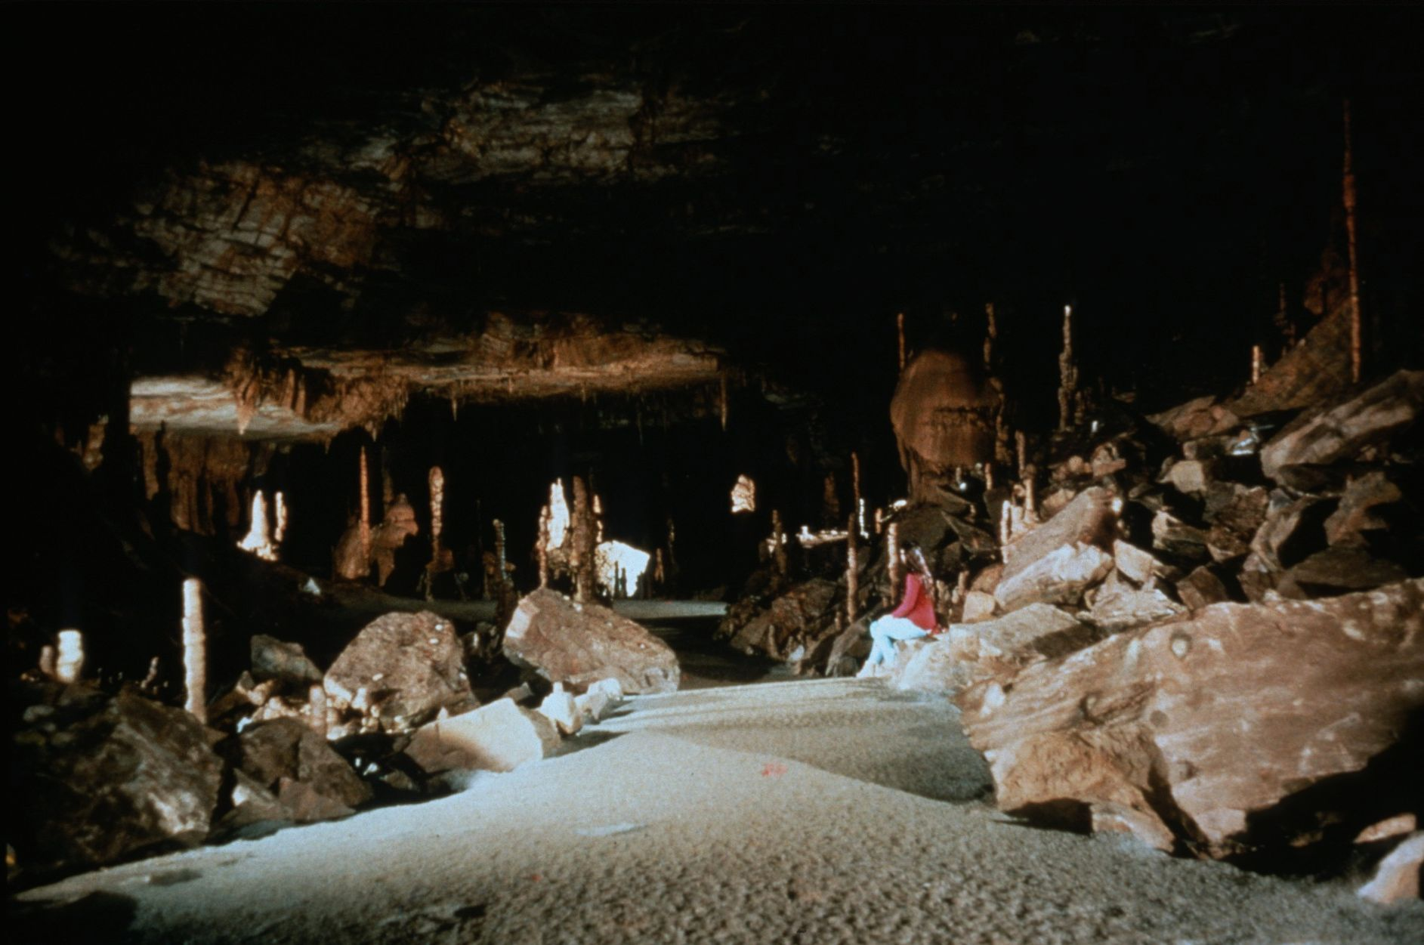
Notes:
Painted Desert – John Van Swearingen, IV

Slide 18
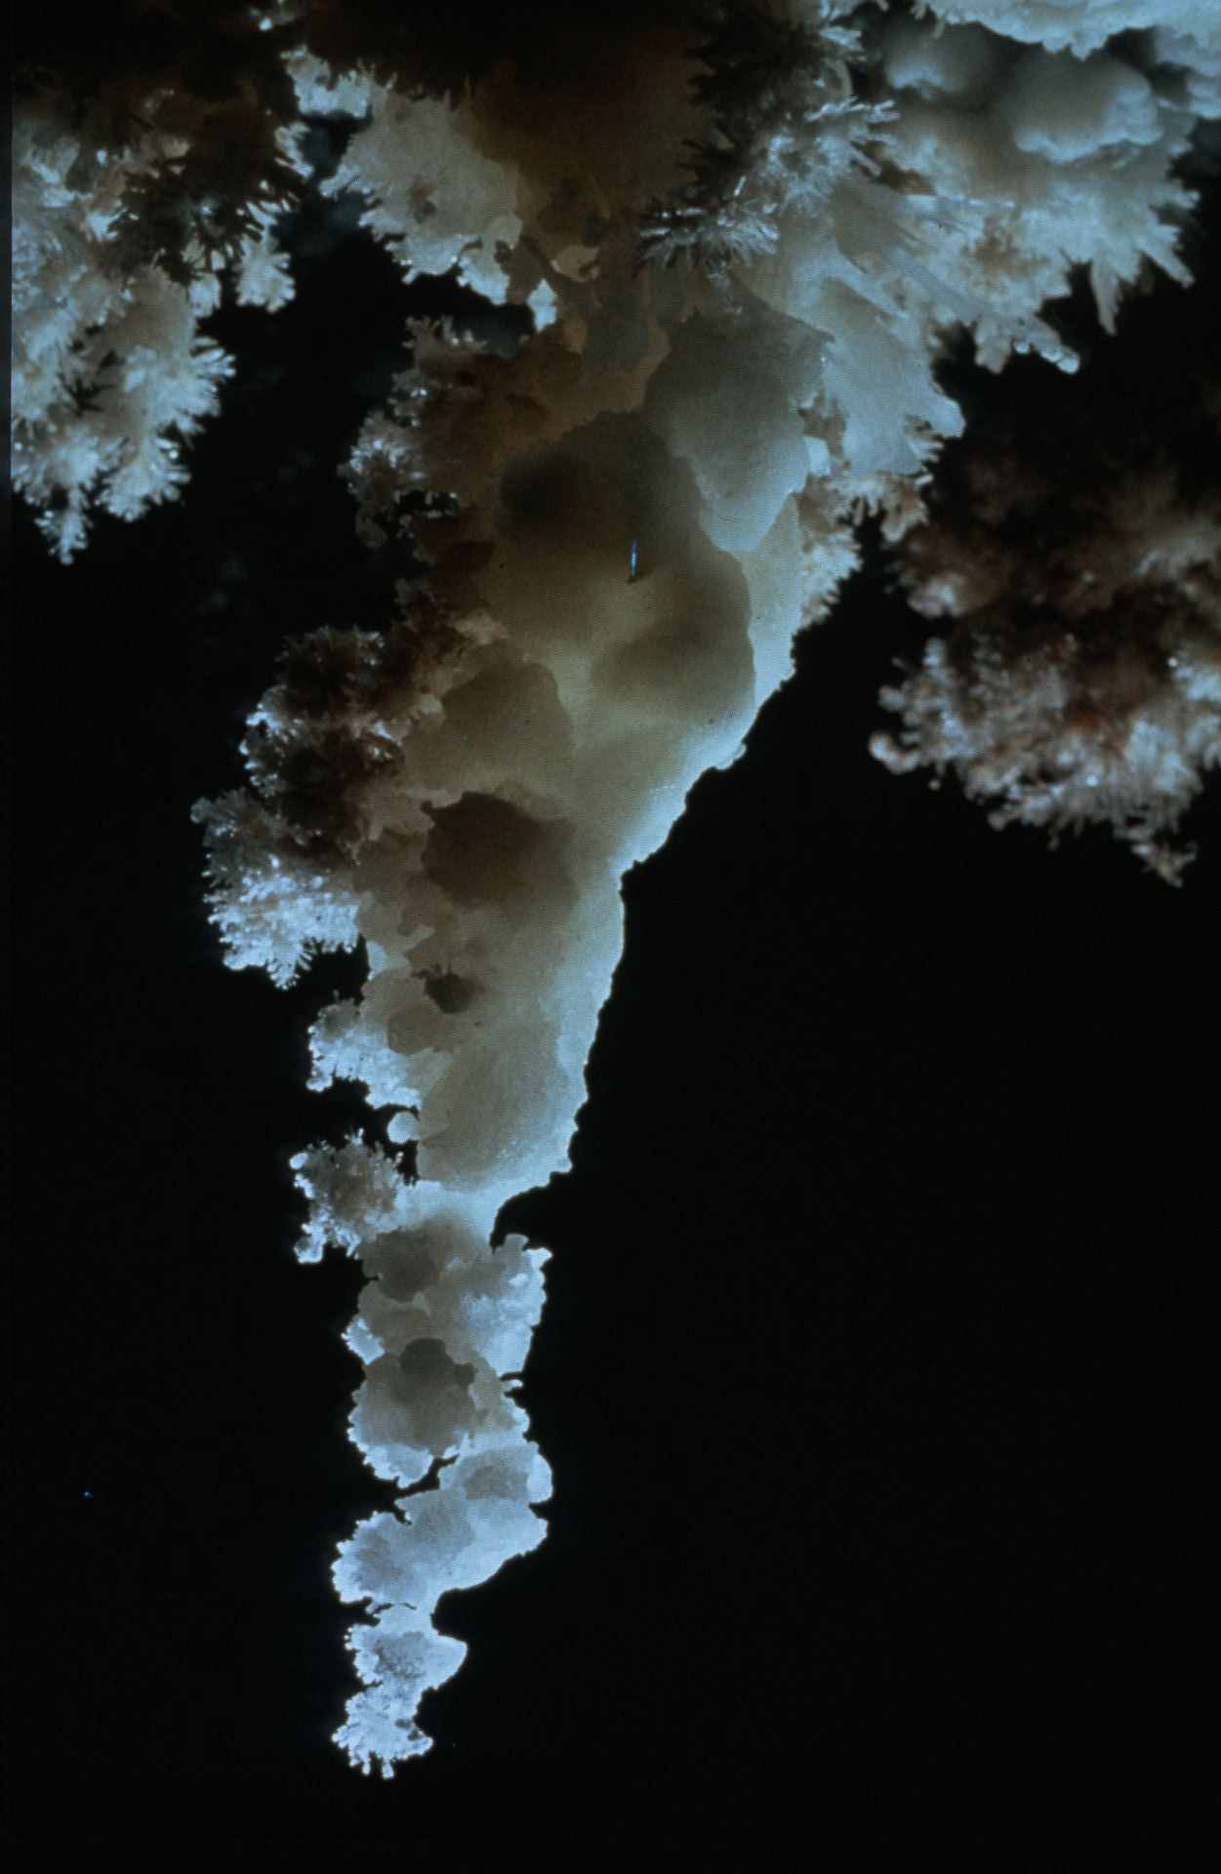
Notes:
Undercover Beauty – Peter and Ann Bosted

Slide 19
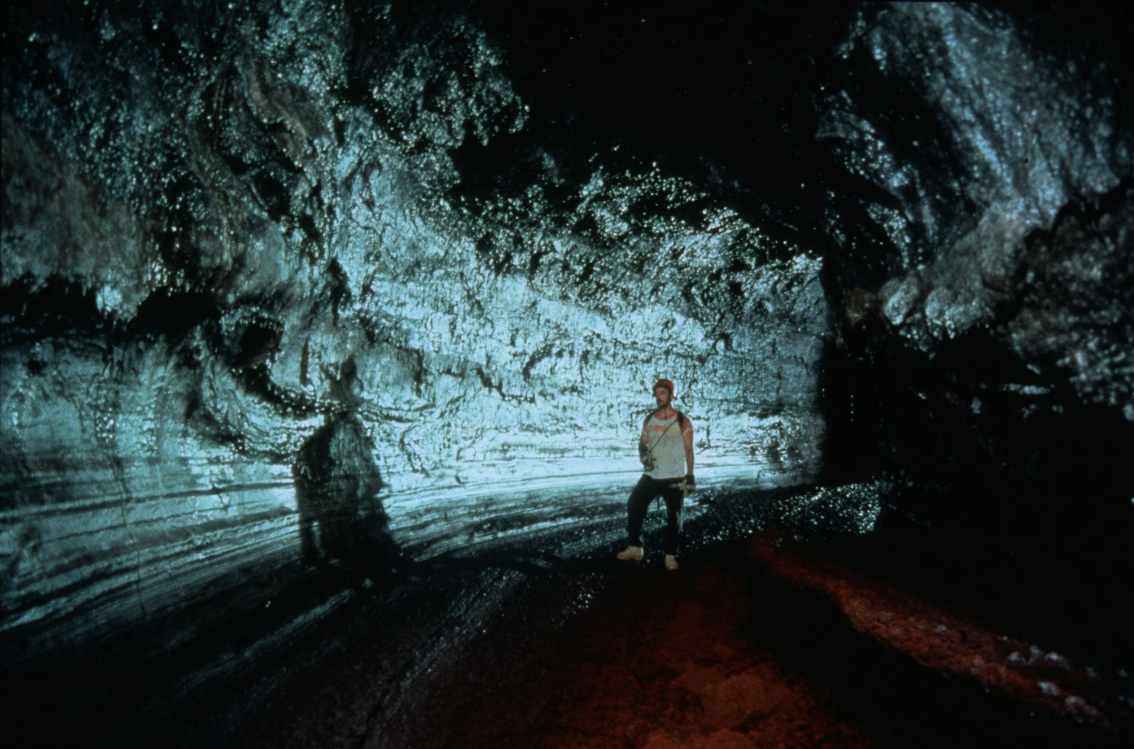
Notes:
Tubular Contrasts – Dave Bunnell

Slide 20
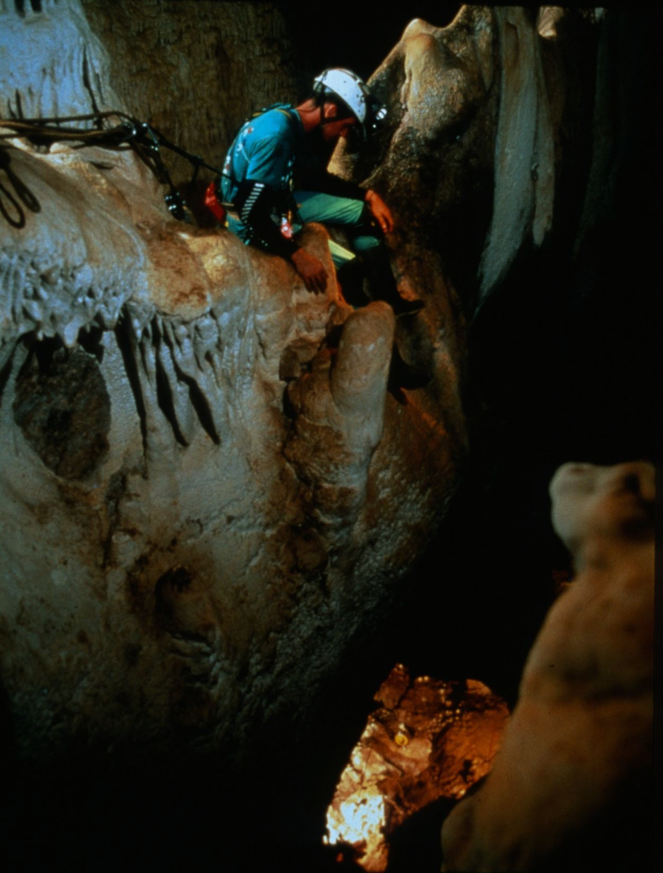
Notes:
Expose Yourself to Lead Climbing – David Harris

Slide 21
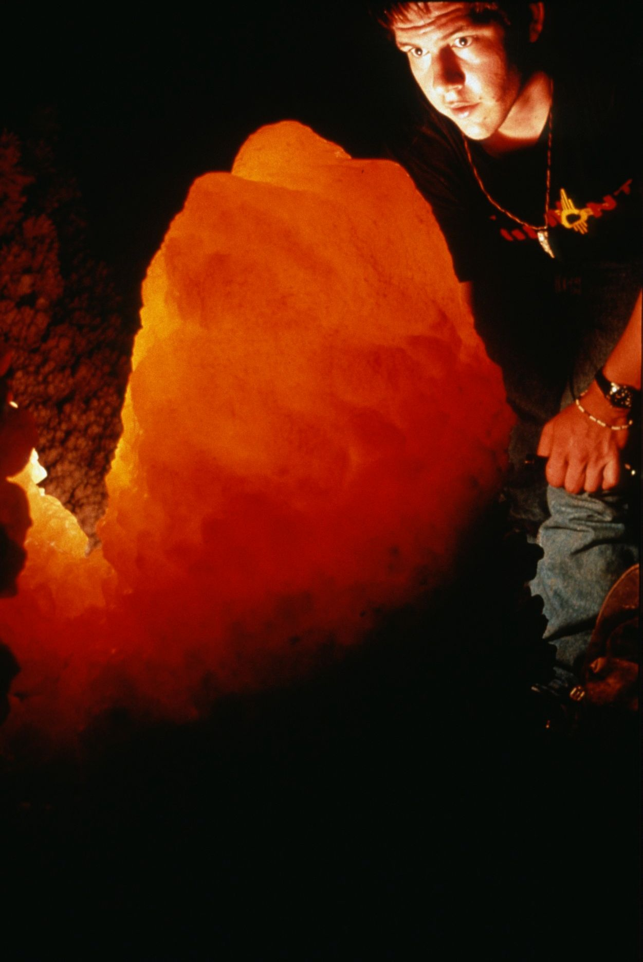
Notes:
Meltdown – John Langevin

Slide 22
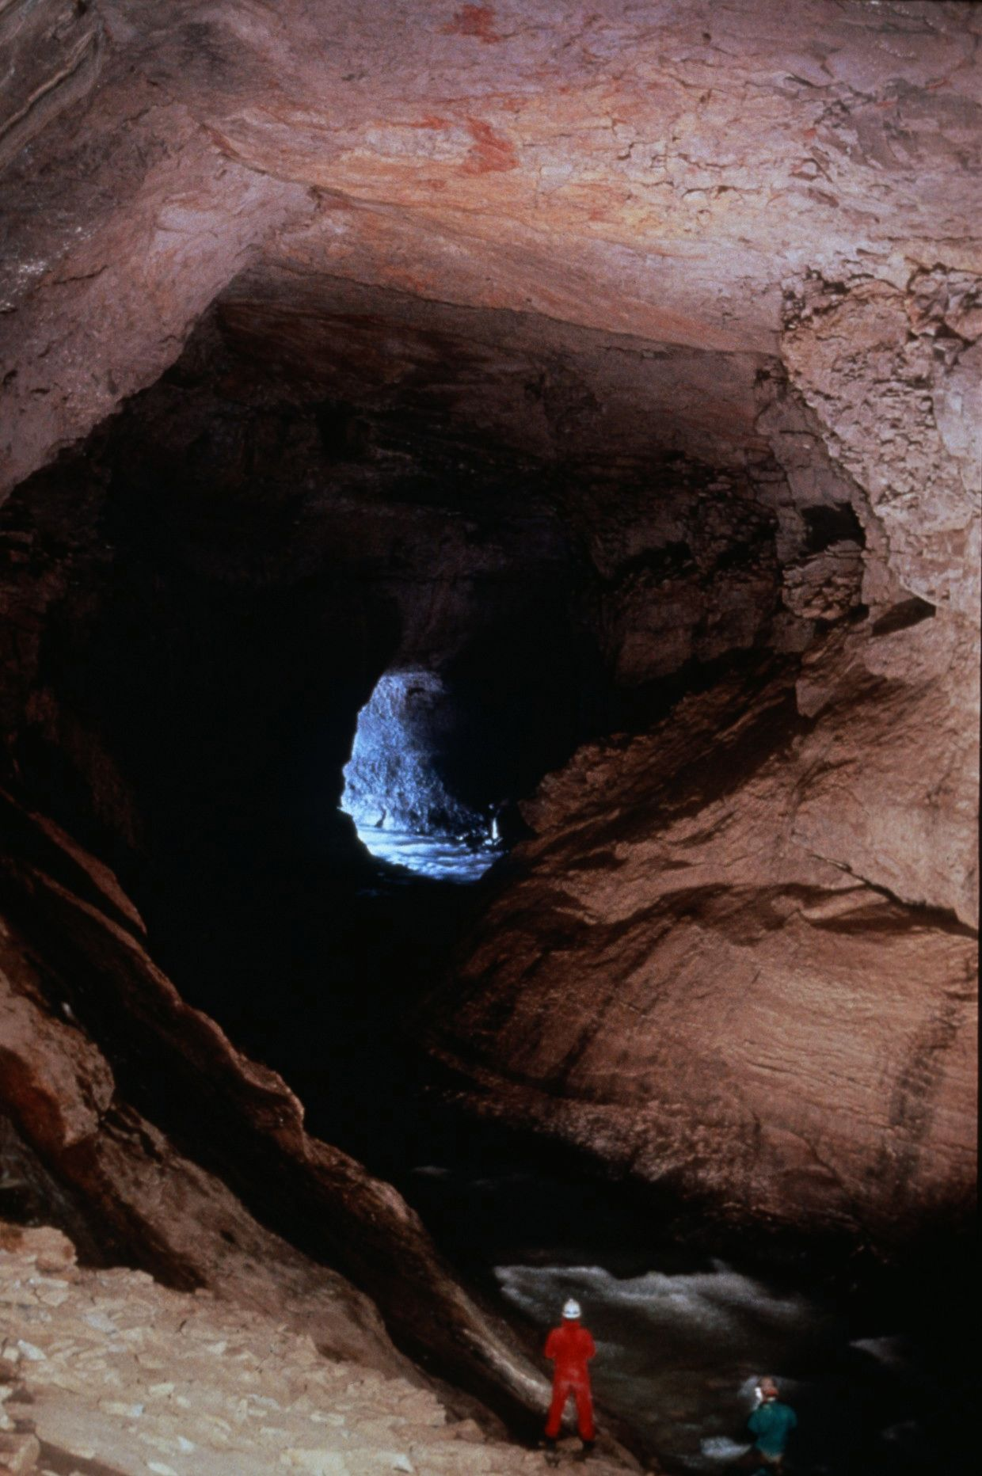
Notes:
I See the Light – Ed McCarthy and Carl Samples

Slide 23
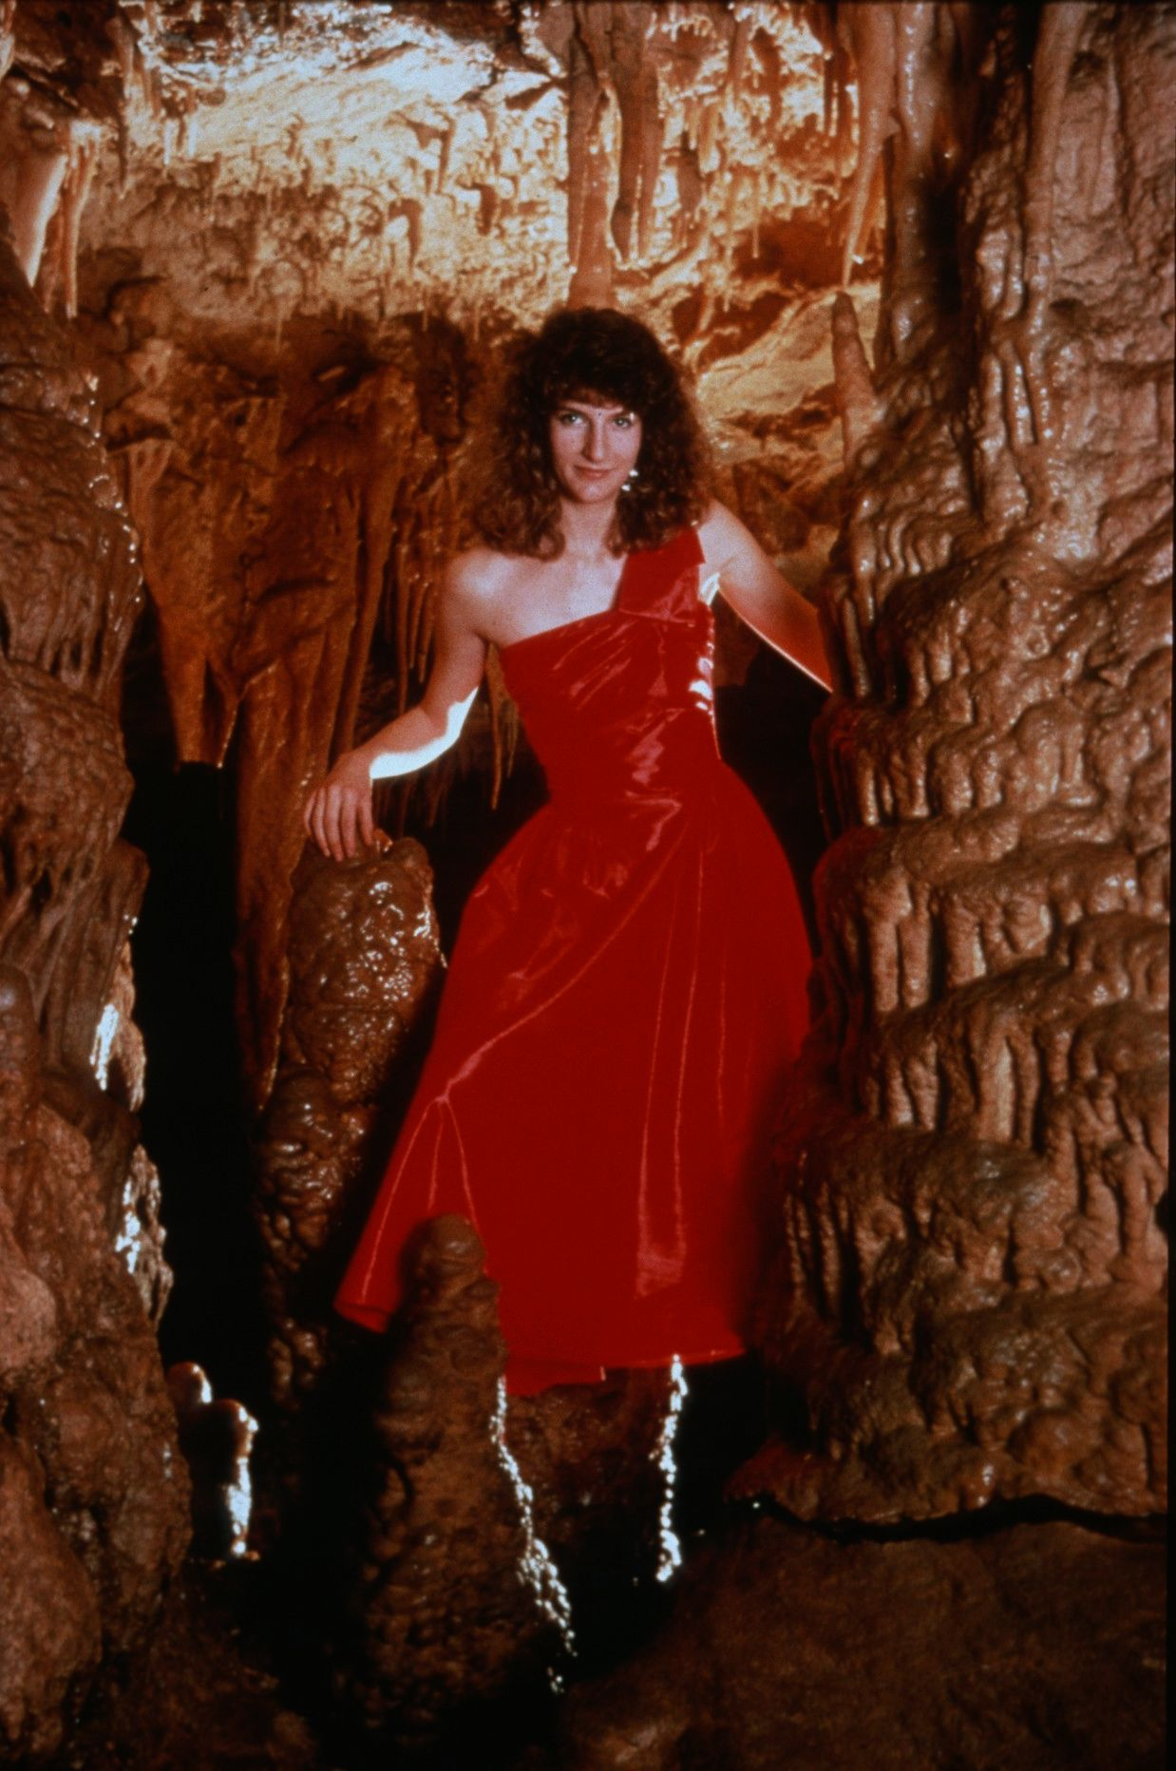
Notes:
Floating – John Van Swearingen, IV

Slide 24
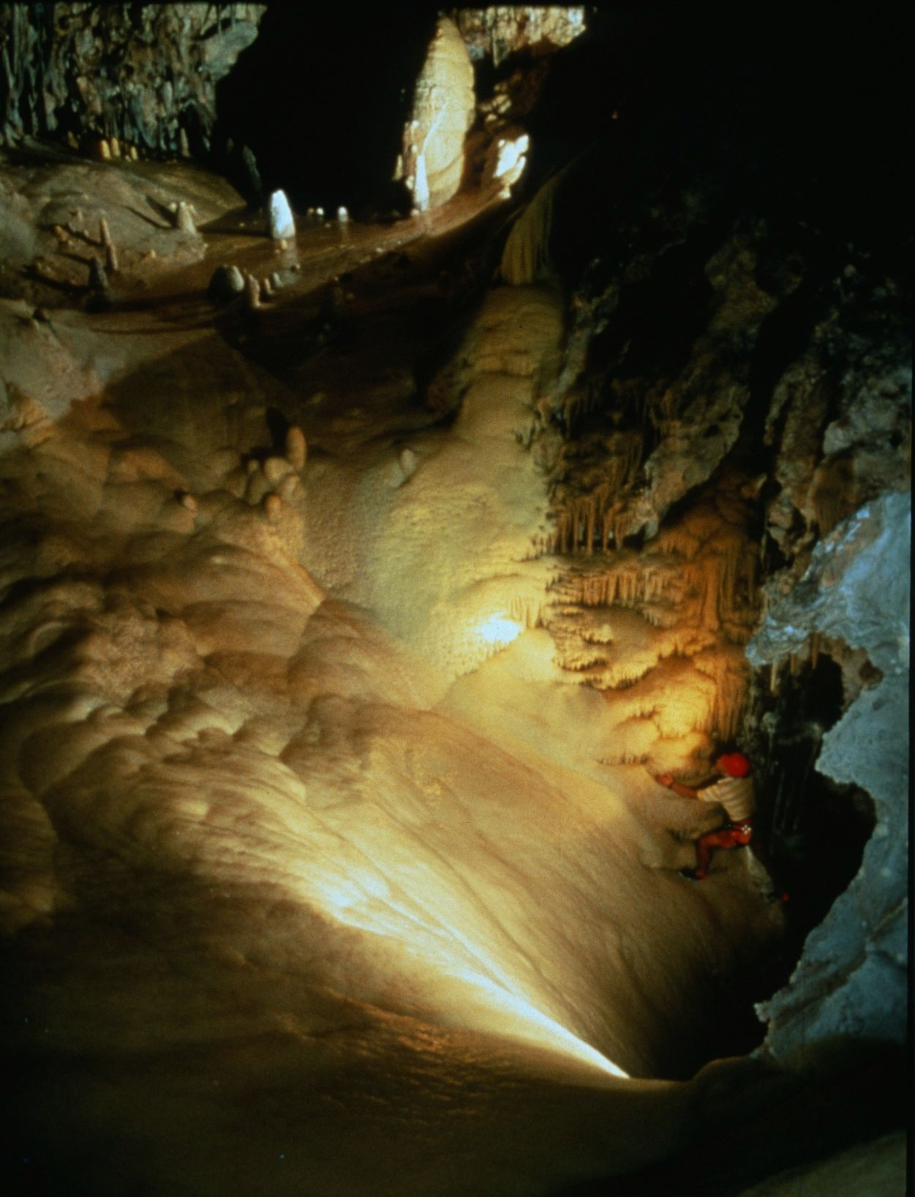
Notes:
The Gravity Well – David Harris

Slide 25
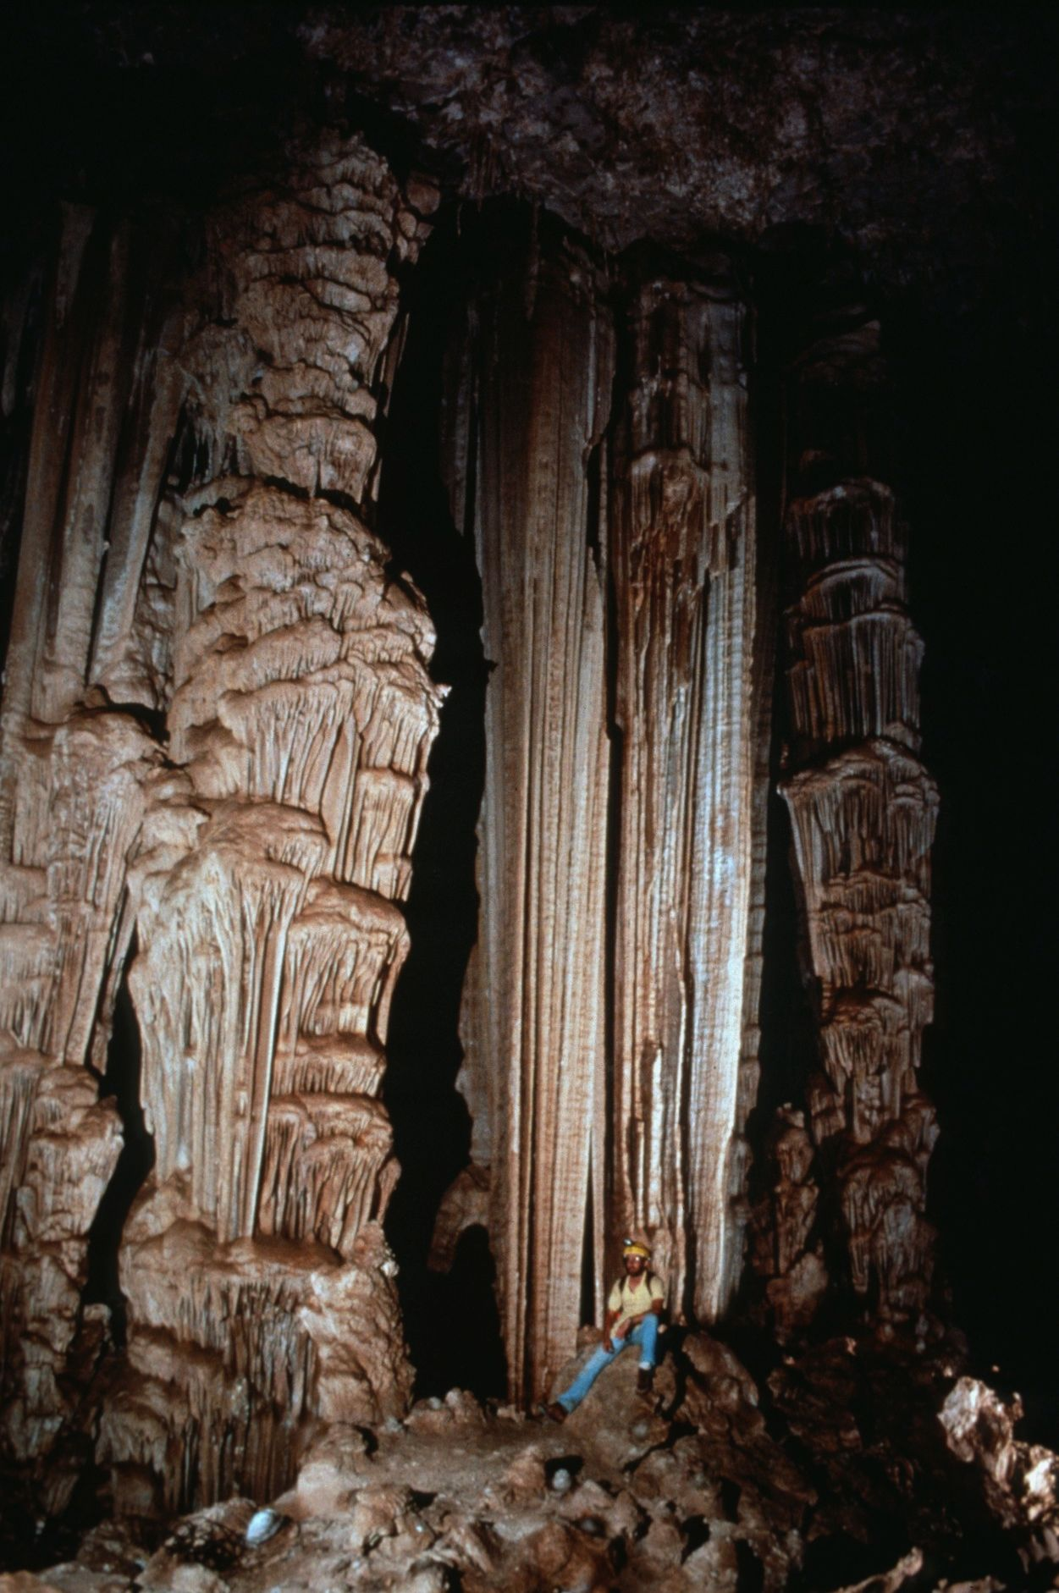
Notes:
Half Dome – Robert Montgomery

Slide 26
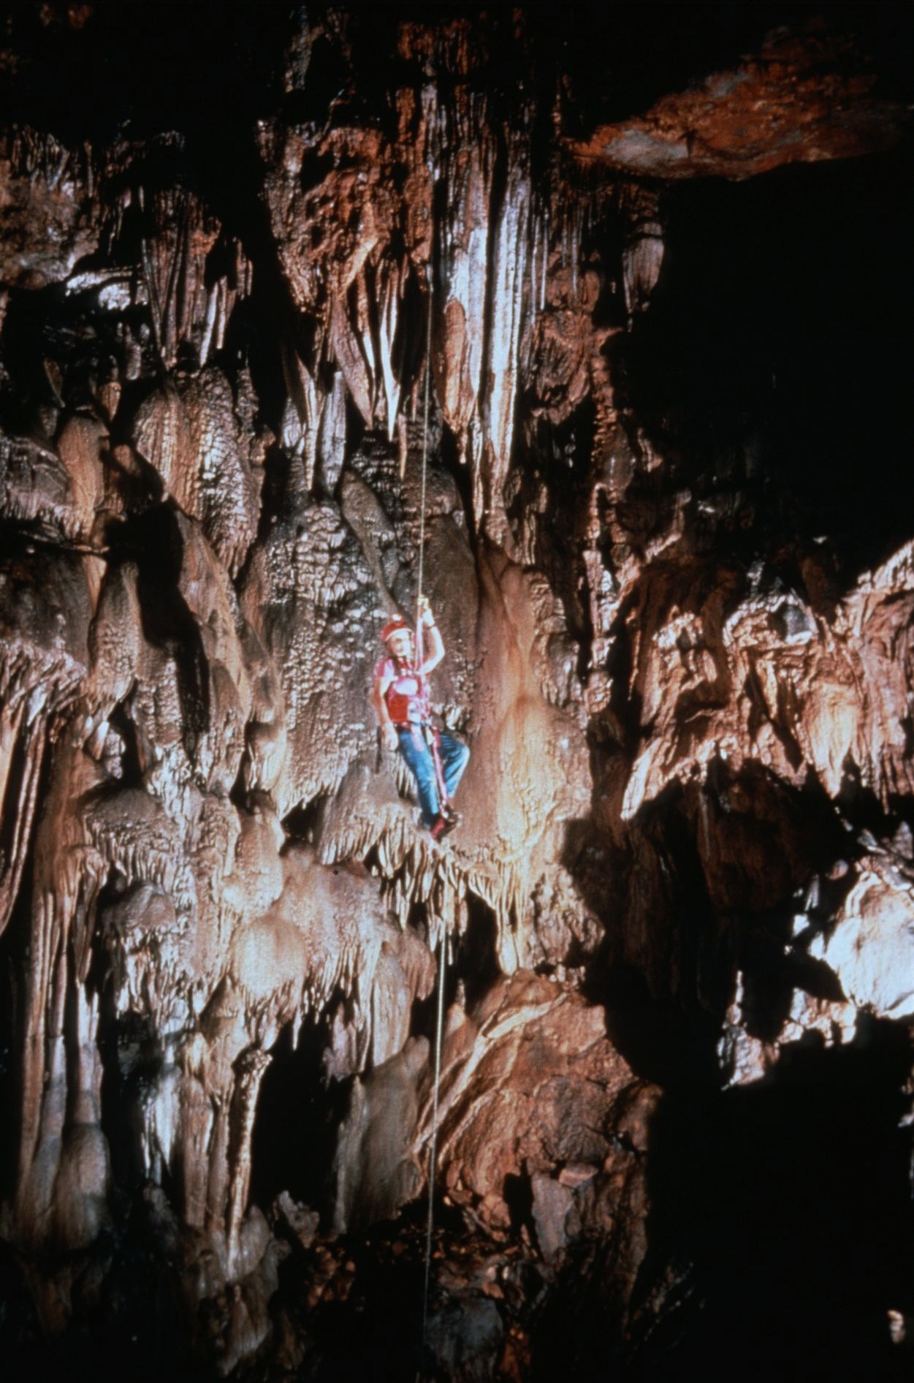
Notes:
Hanging High! – John Van Swearingen, IV

Slide 27
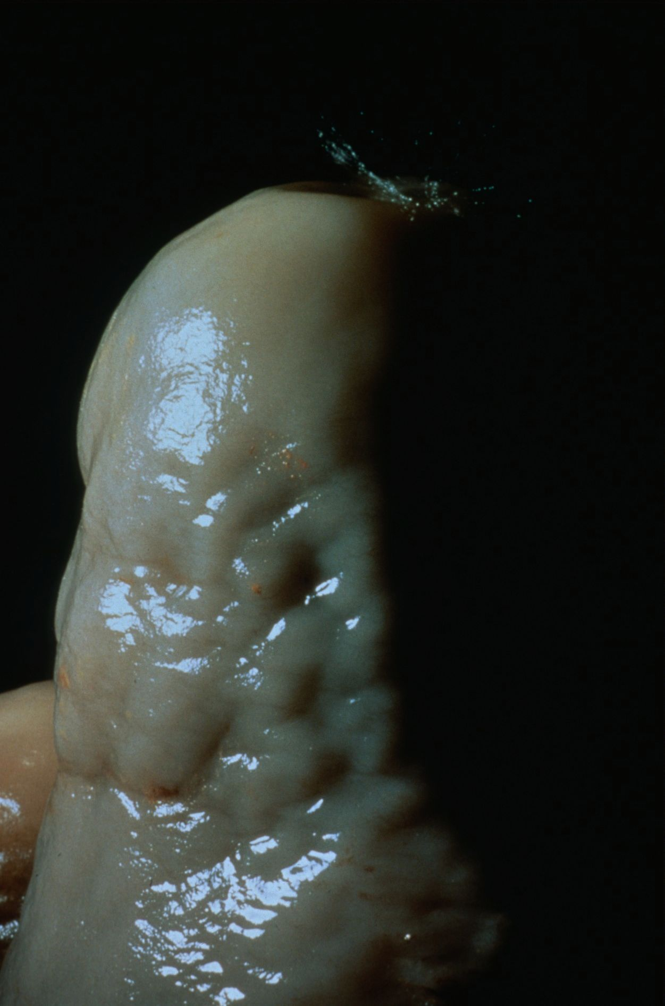
Notes:
A Single Drop – David Harris

Slide 28
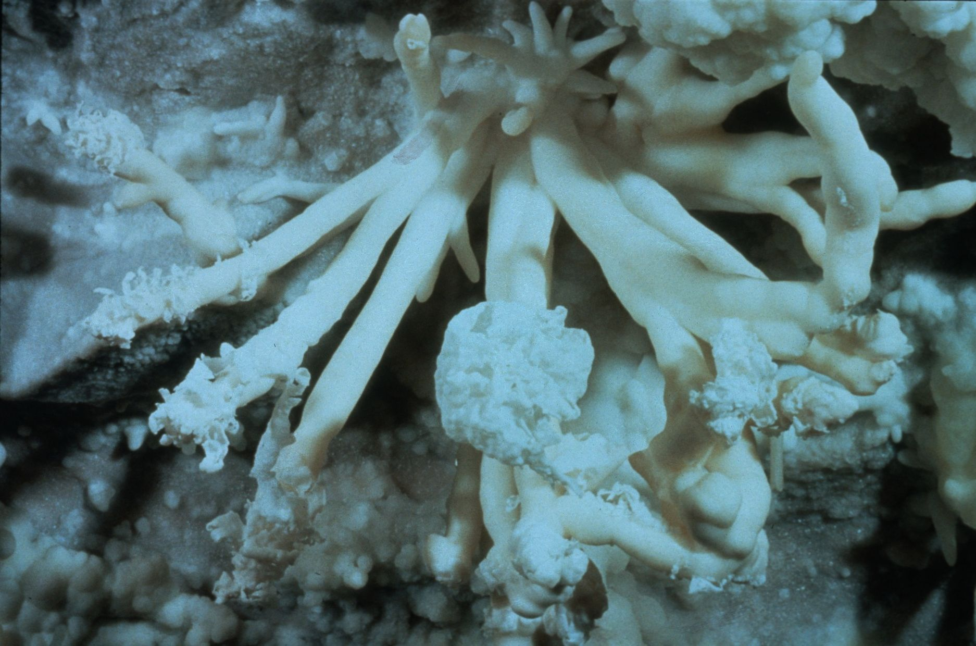
Notes:
Mystery History – Peter and Ann Bosted

Slide 29
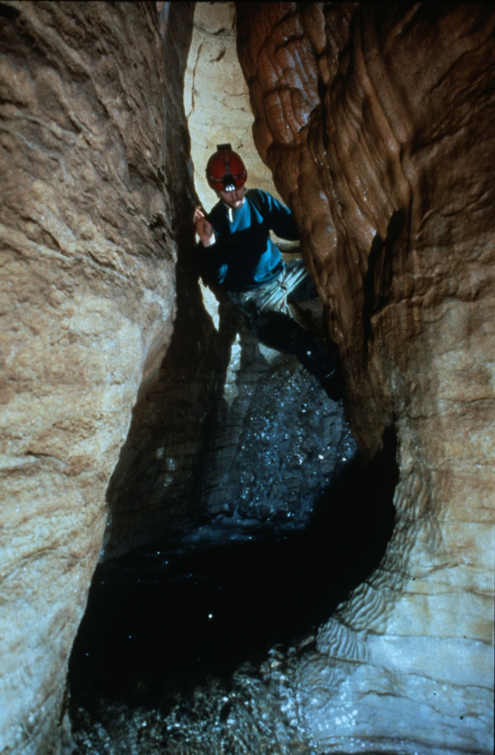
Notes:
Mystery History – Peter and Ann Bosted

Slide 30
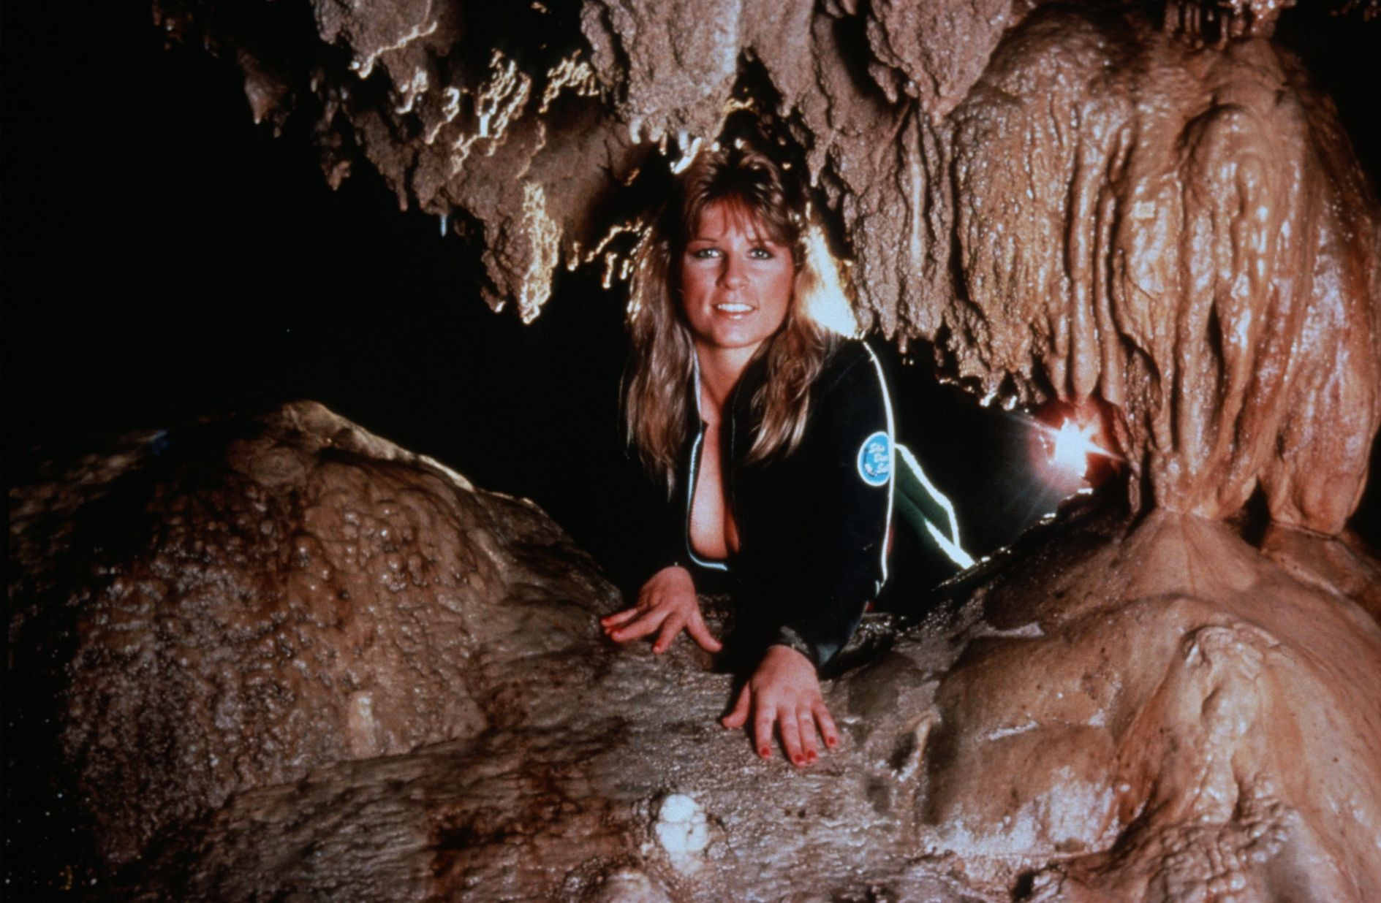
Notes:
Hold Up, I Broke My Nail – John Van Swearingen, IV

Slide 31
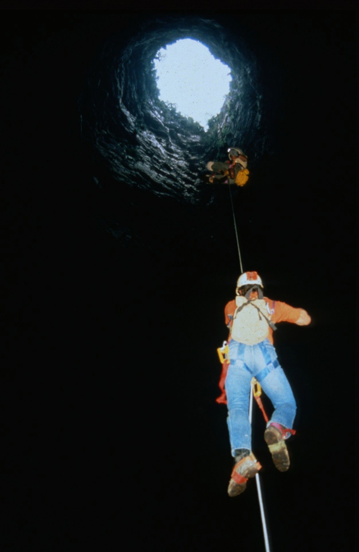
Notes:
The Long Way Out of Big G – Jay Jordan

Slide 32
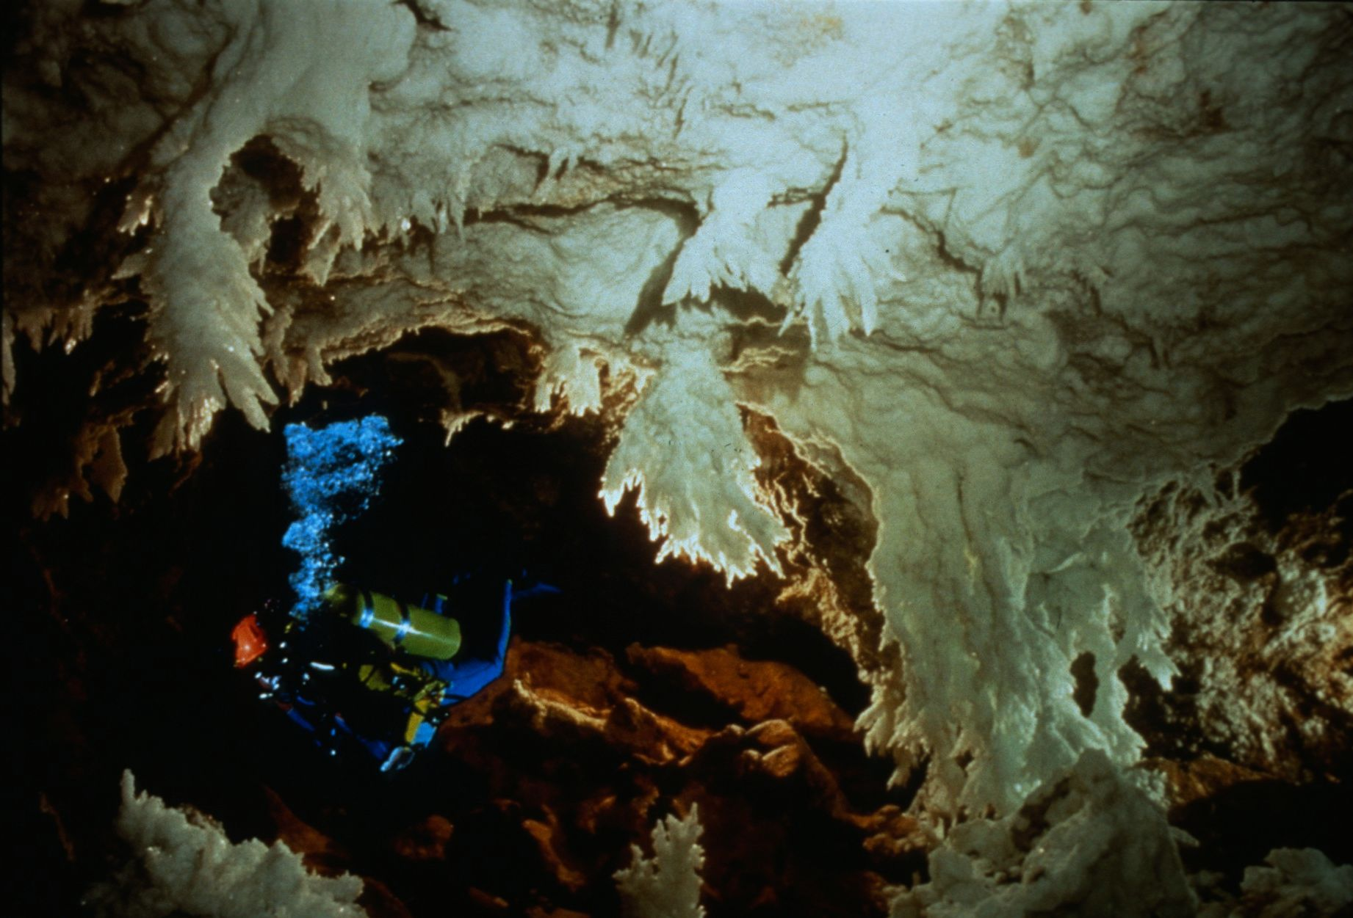
Notes:
Diving the Chandelier Ballroom – Dave Bunnell and Djuna Bewley

Slide 33
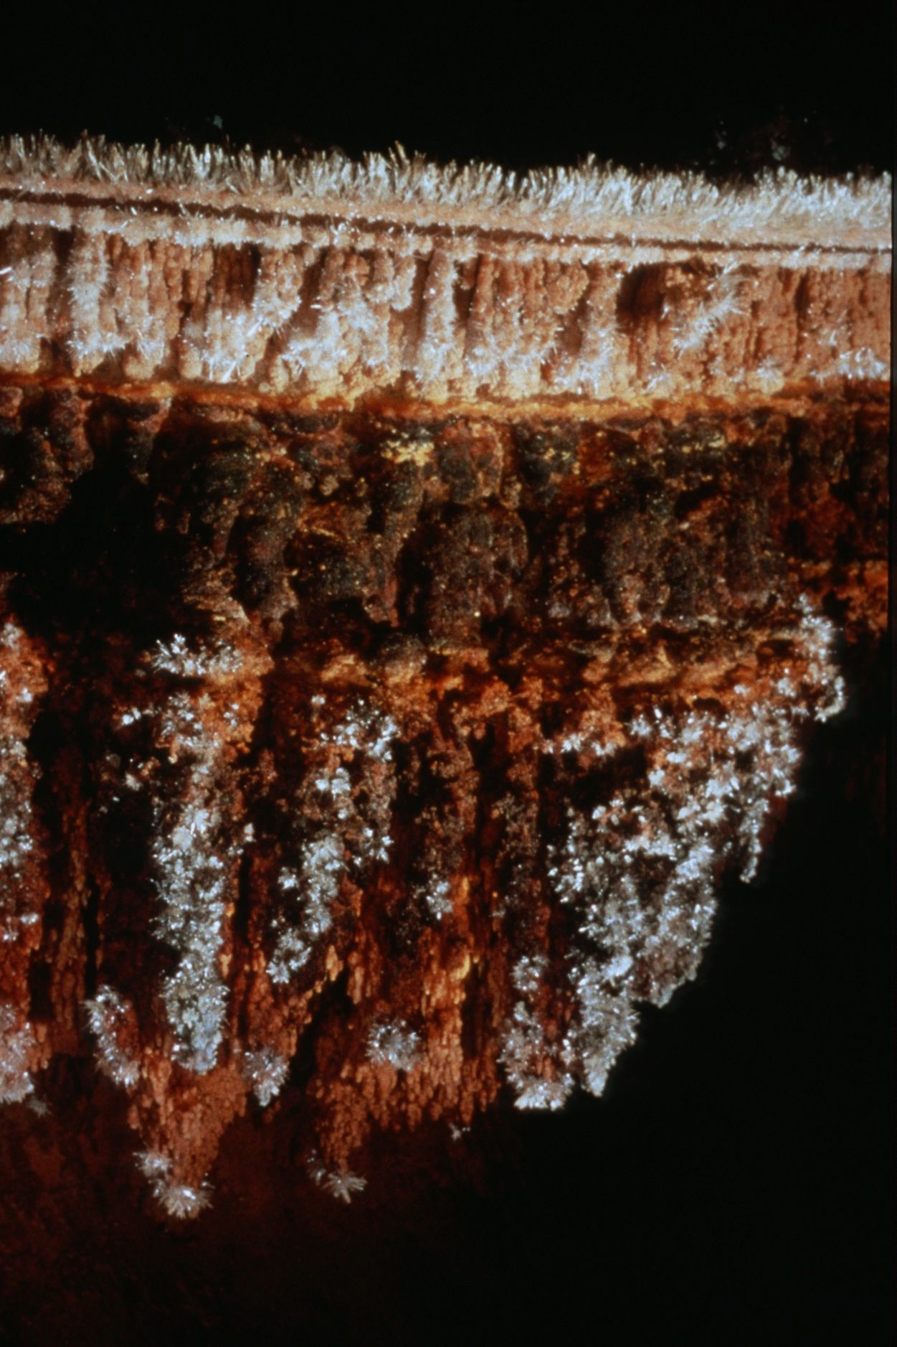
Notes:
Frosted Layers – Peter and Ann Bosted

Slide 34
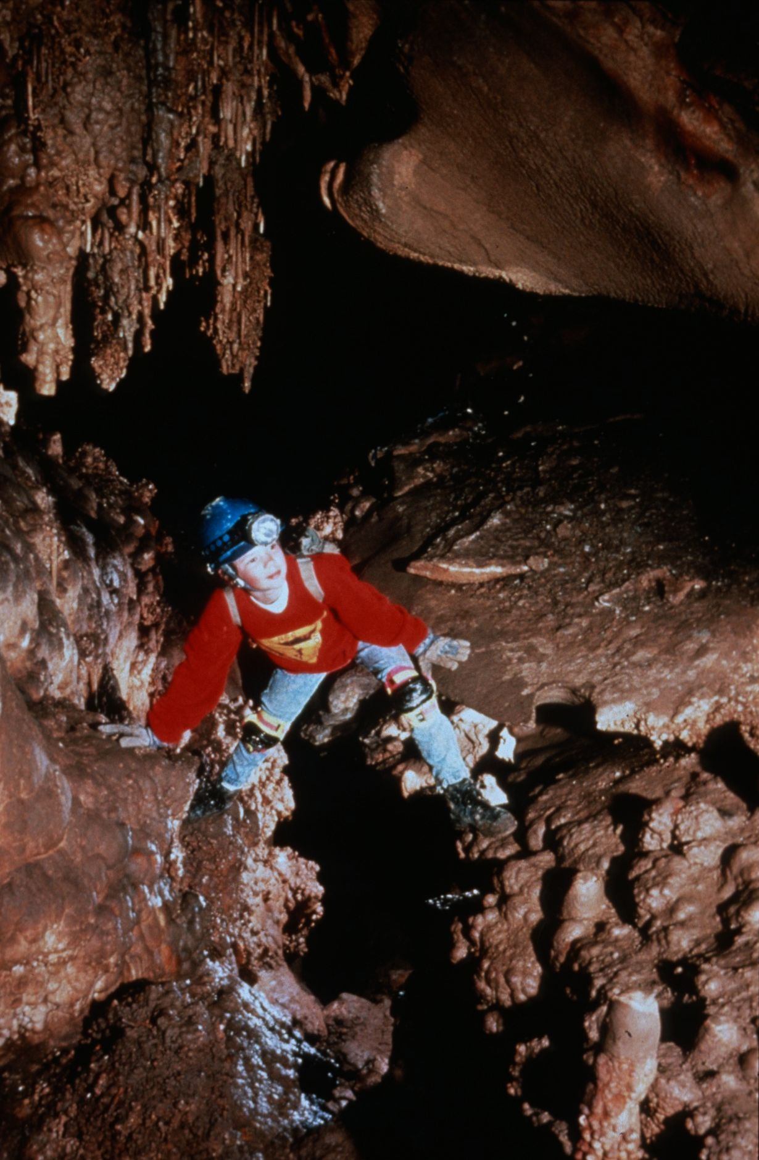
Notes:
Forever Young – John Van Swearingen, IV

Slide 35
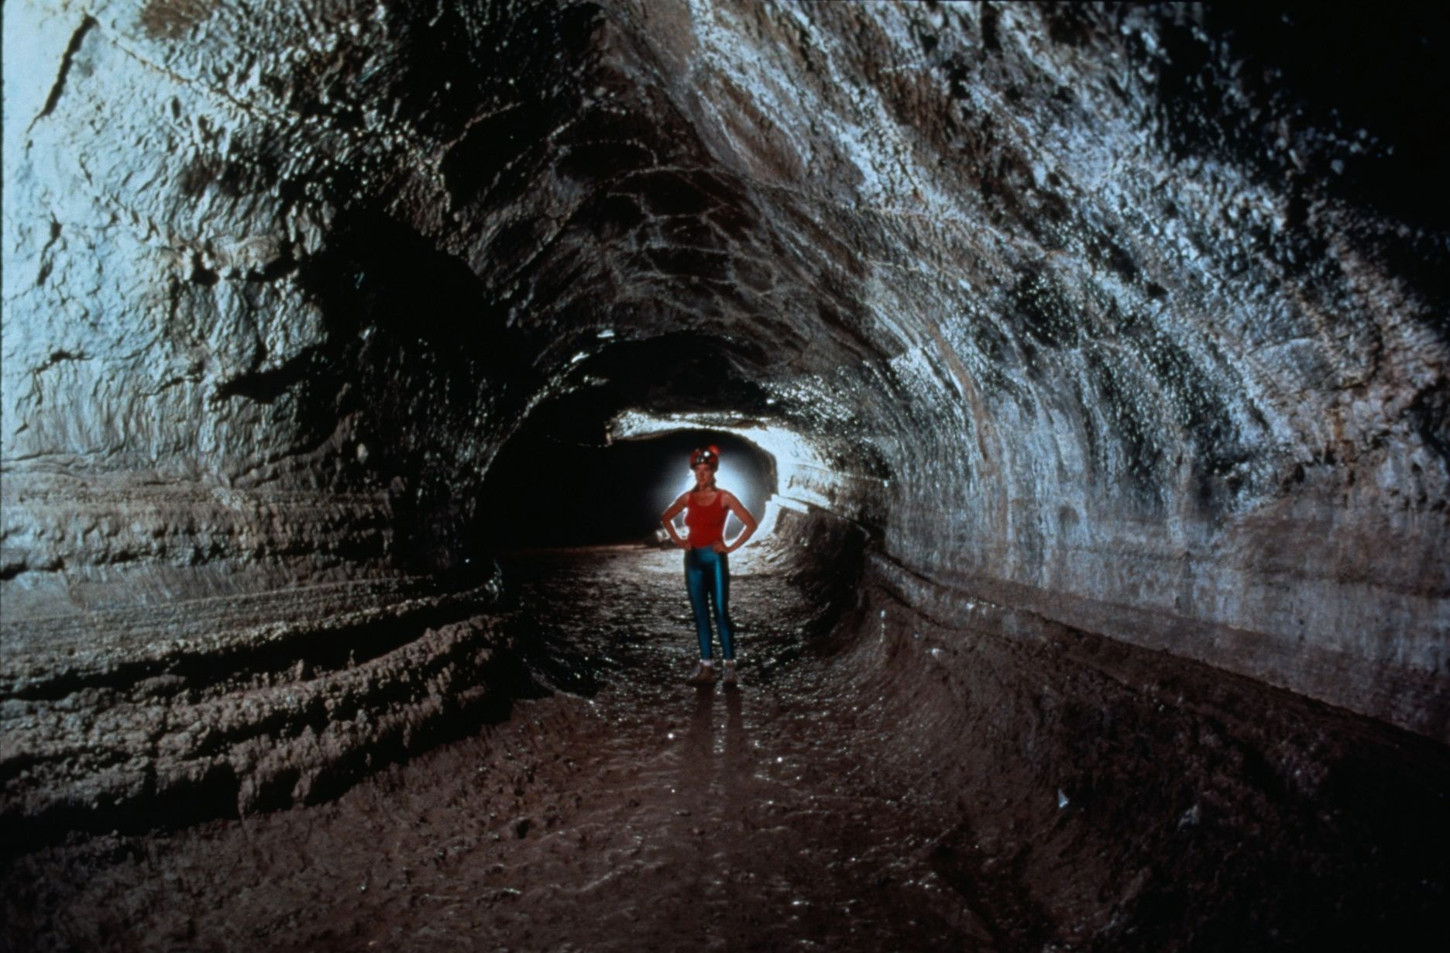
Notes:
Totally Tubular – Dave Bunnell and Djuna Bewley

Slide 36
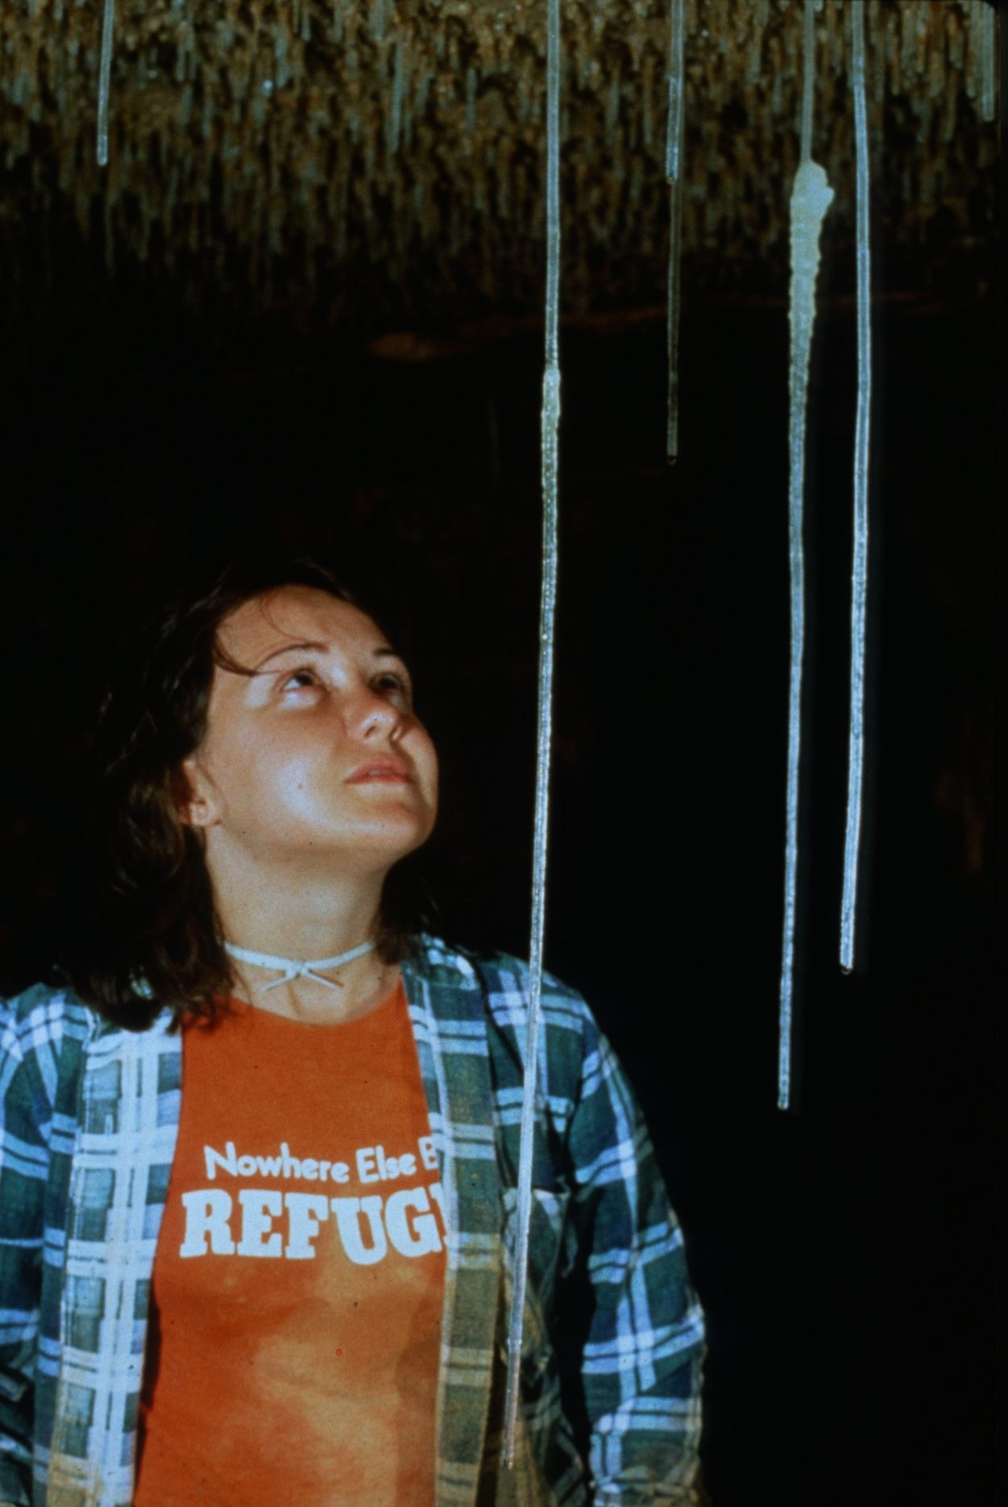
Notes:
Soda Straws at Inner Space – Jay Jordan

Slide 37
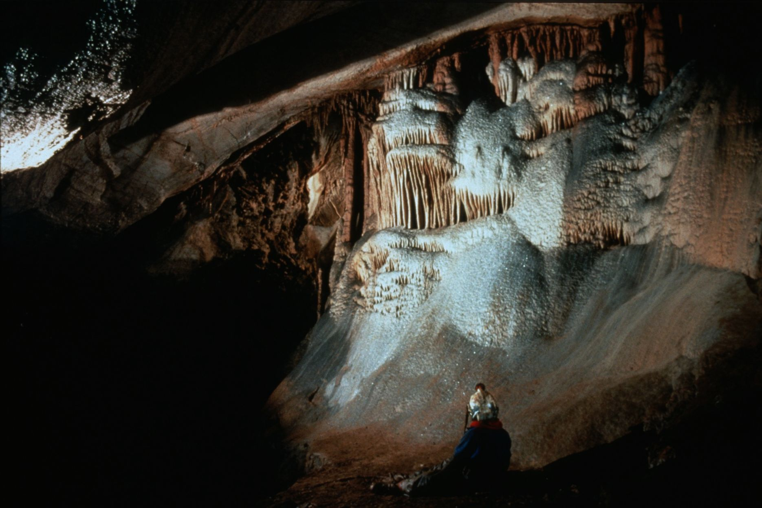
Notes:
Snow White and the Single Dwarf – Ed McCarthy and Carl Samples

Slide 38
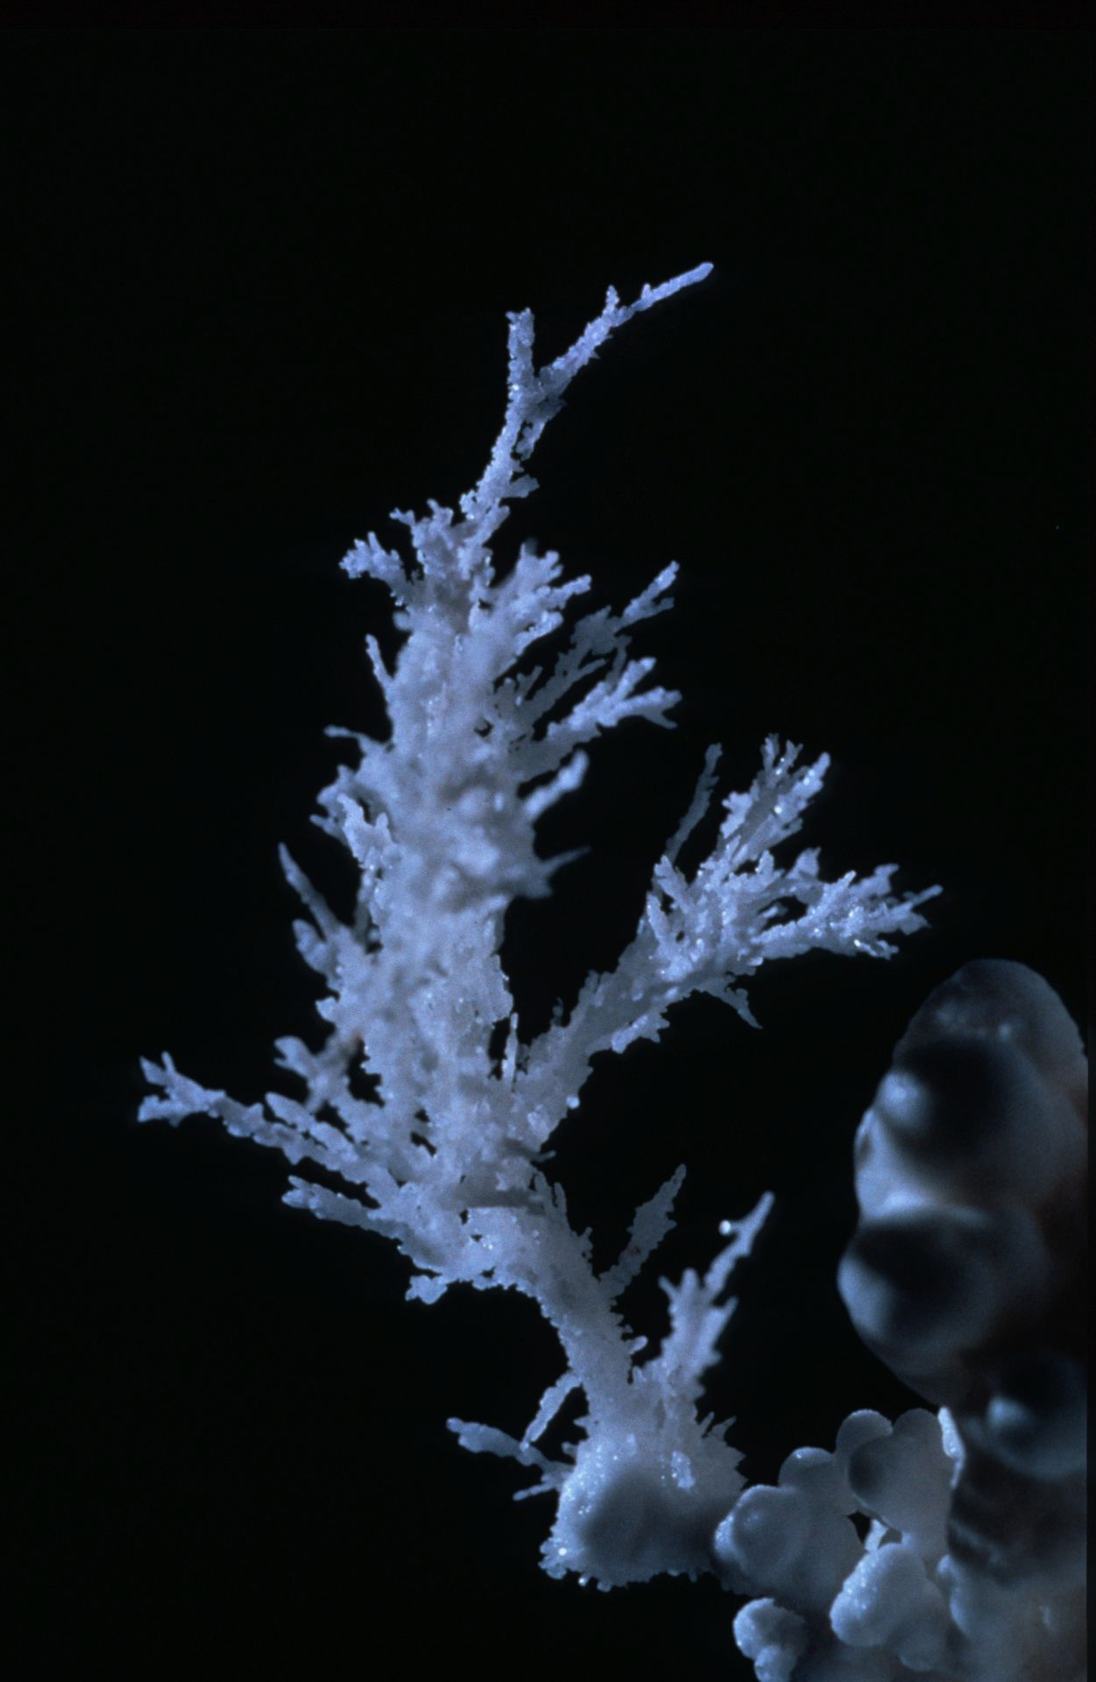
Notes:
Branching Out – Peter and Ann Bosted

Slide 39
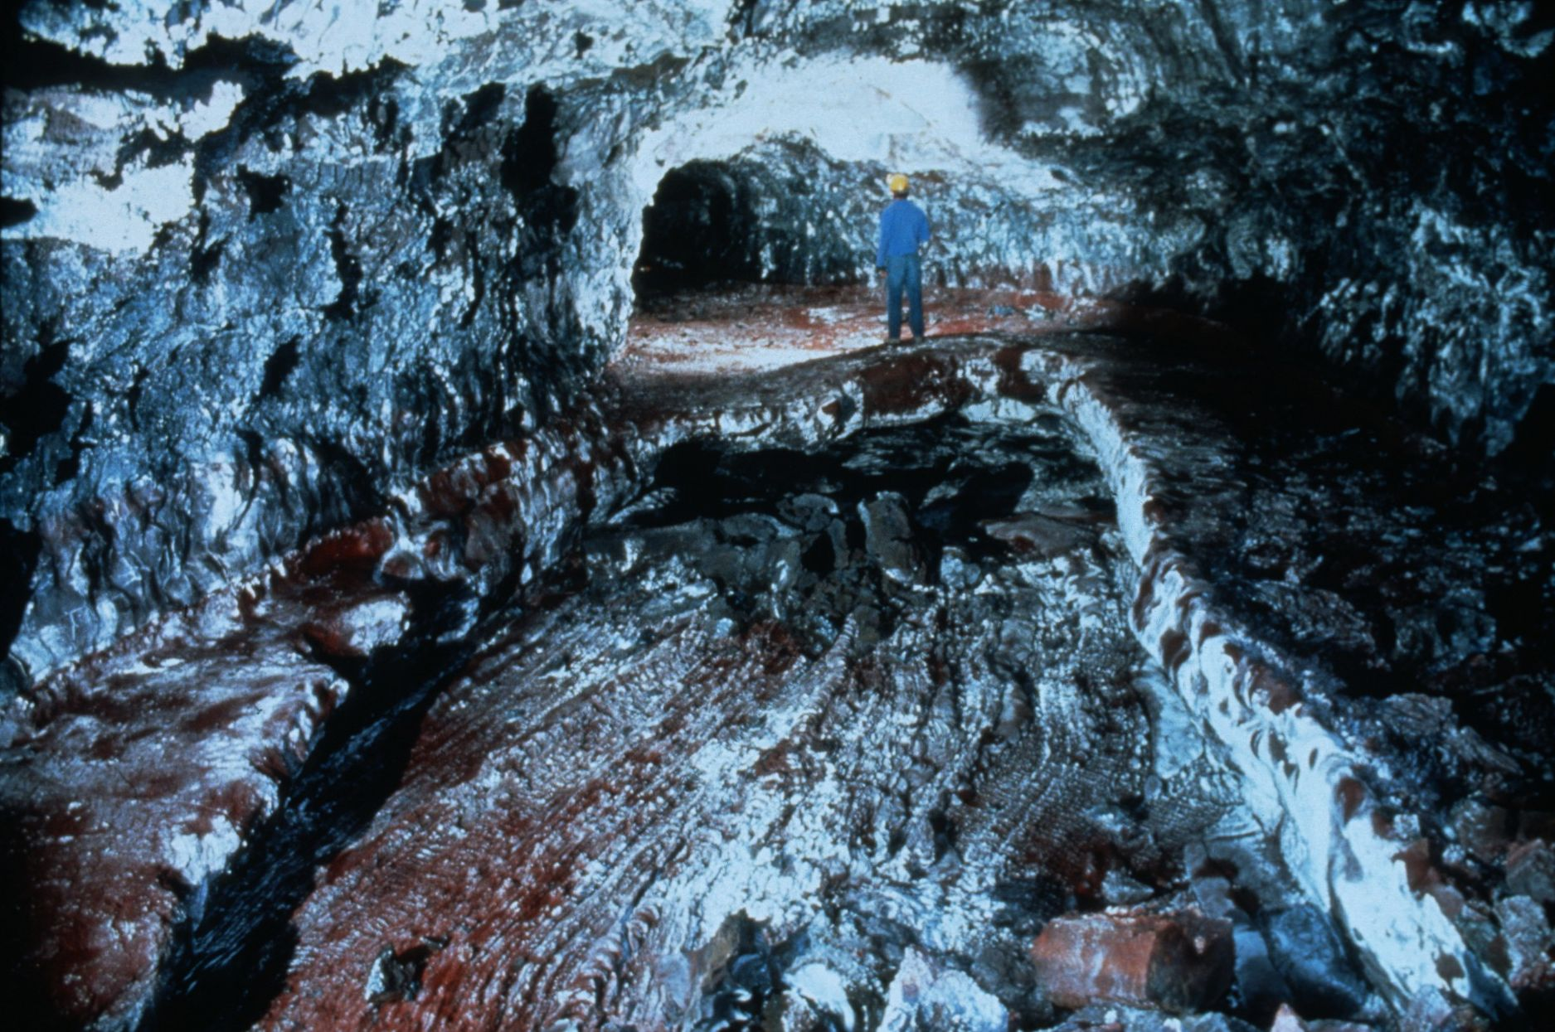
Notes:
Sugared Red Pahoehoe – Dave Bunnell

Slide 40
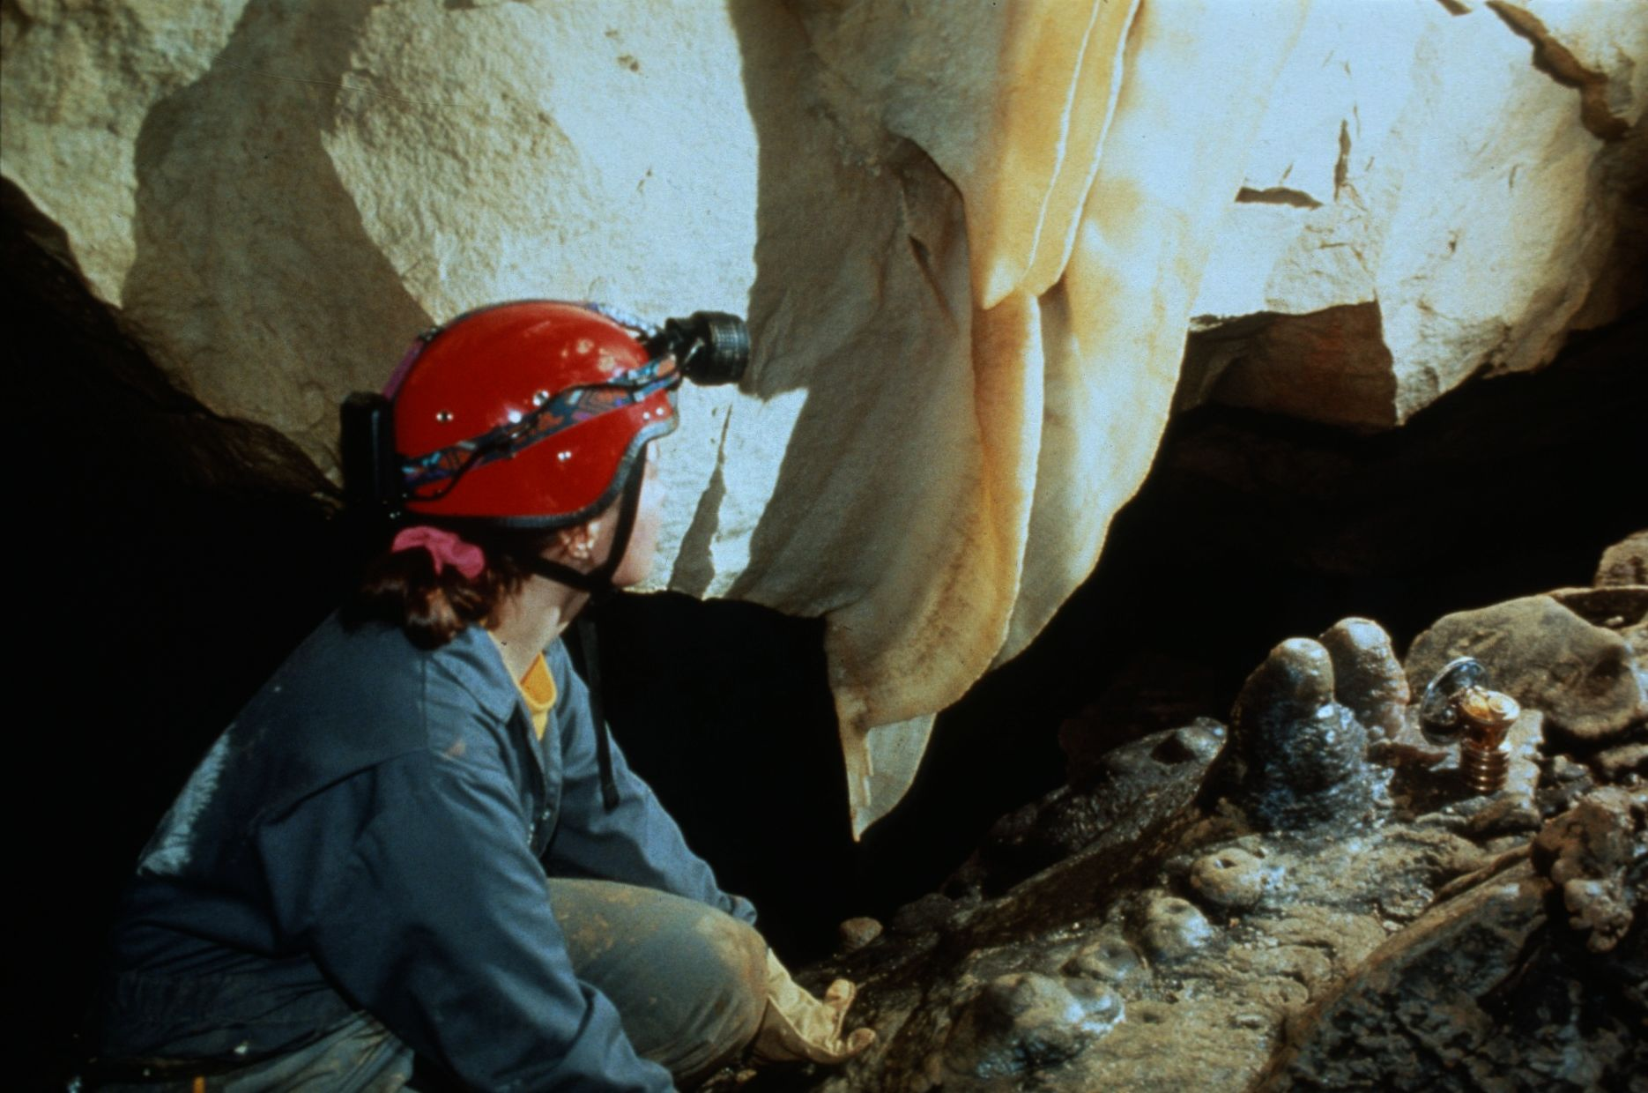
Notes:
Angel Wings – Collin Gatland

Slide 41
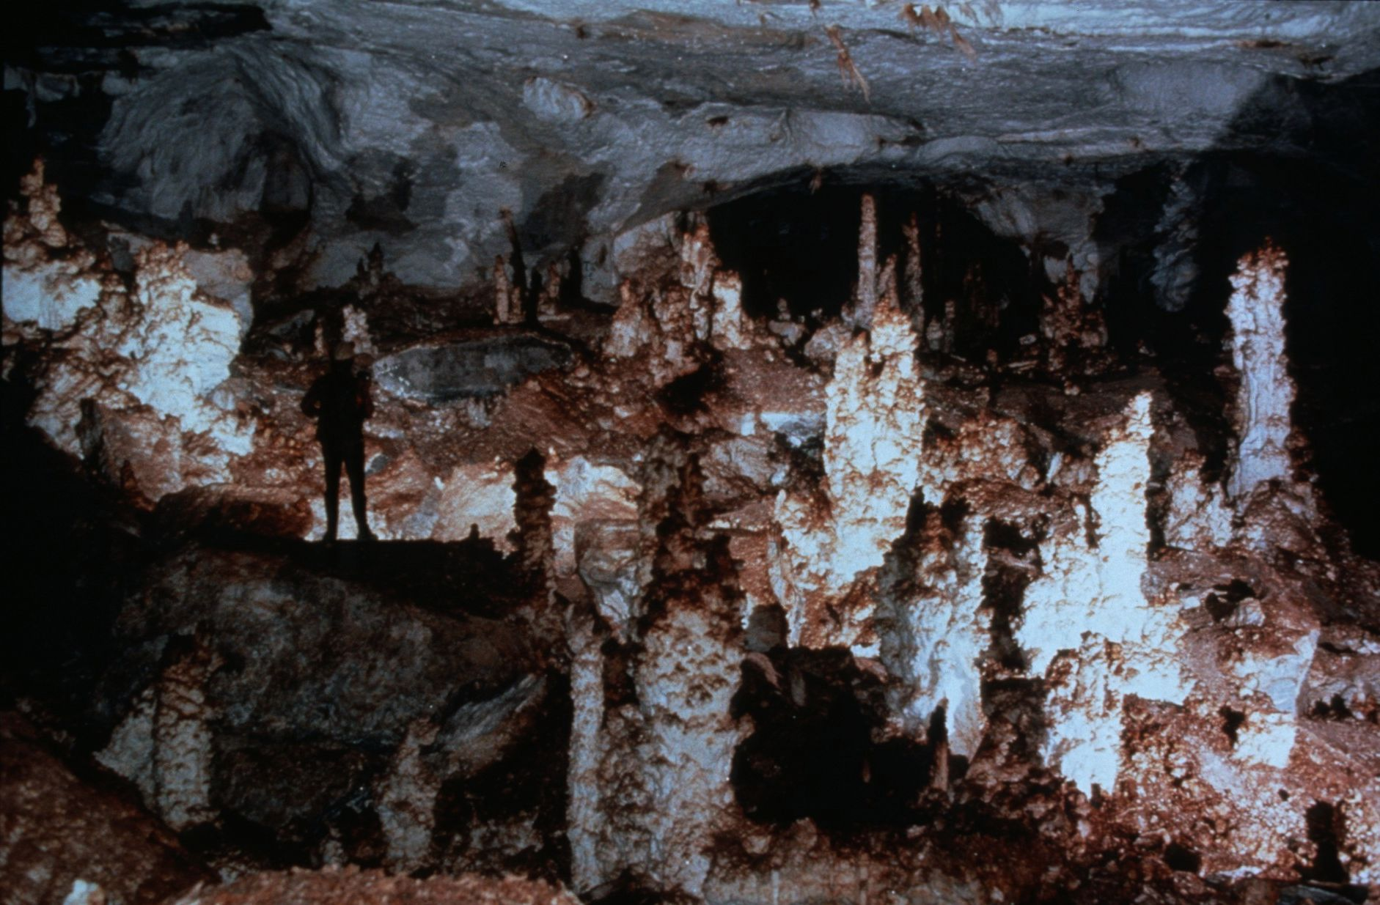
Notes:
Where the Gypsum Forest Grows – Peter and Ann Bosted

Slide 42
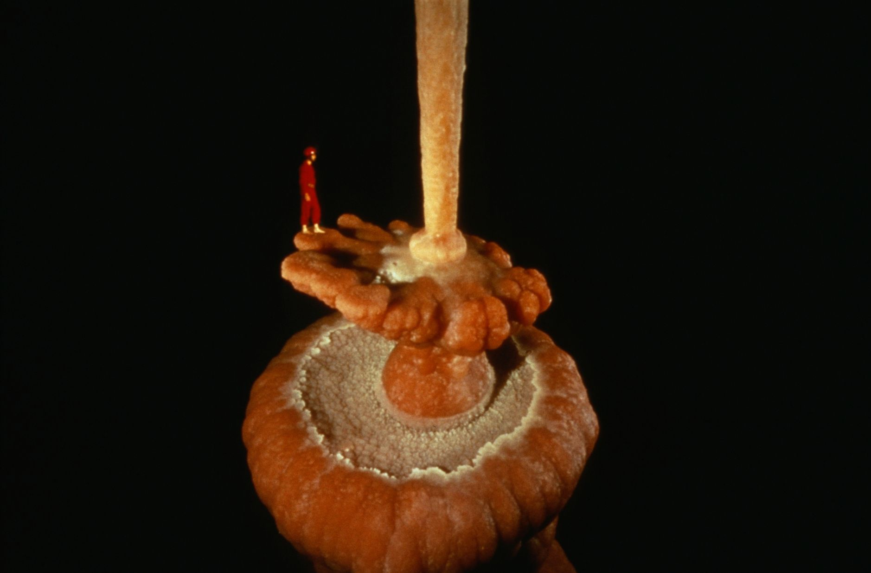
Notes:
Honey, I Shrunk the Caver! – Dave Bunnell

Slide 43
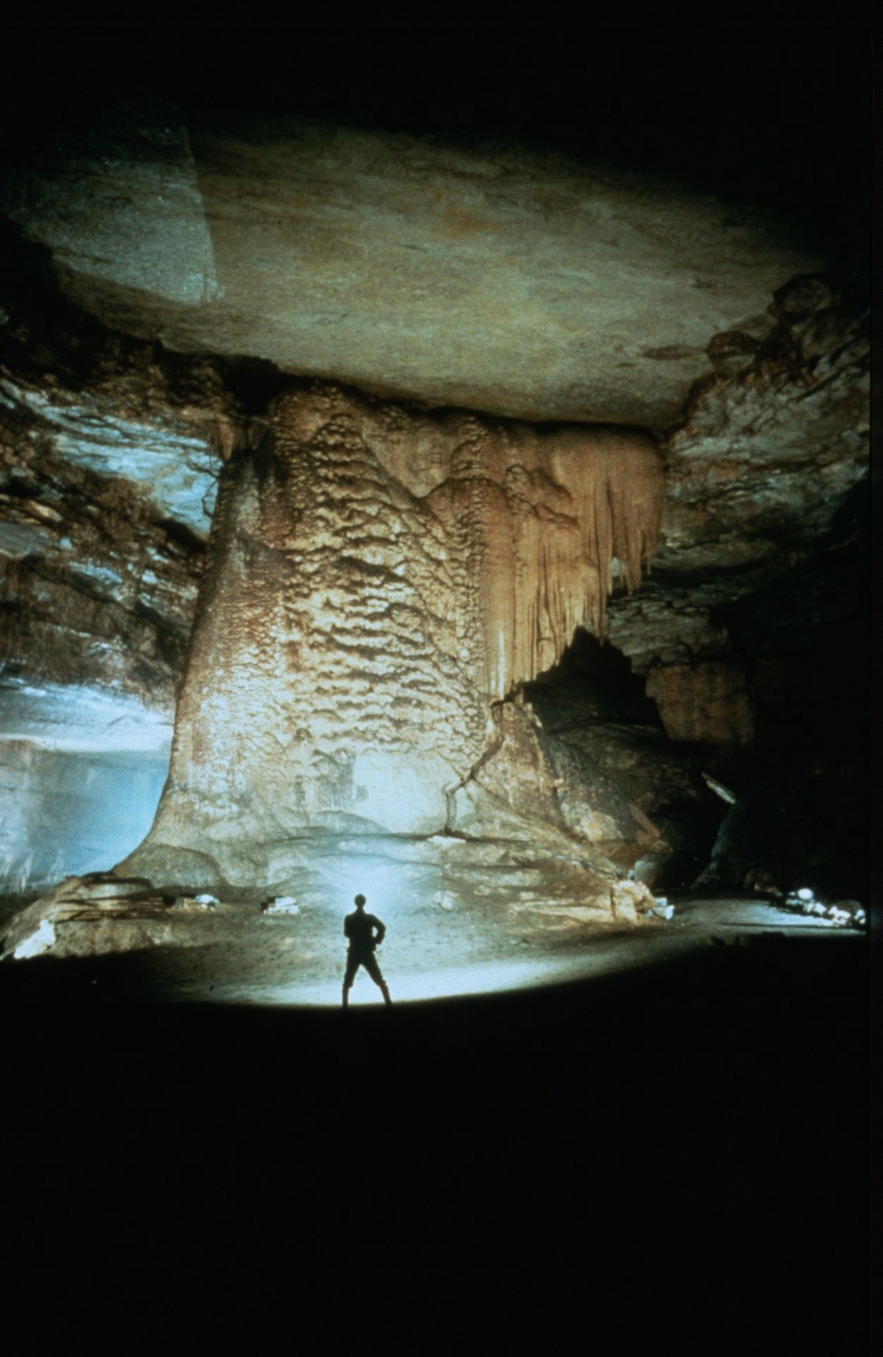
Notes:
David Meets Goliath – John Van Swearingen, IV

Slide 44
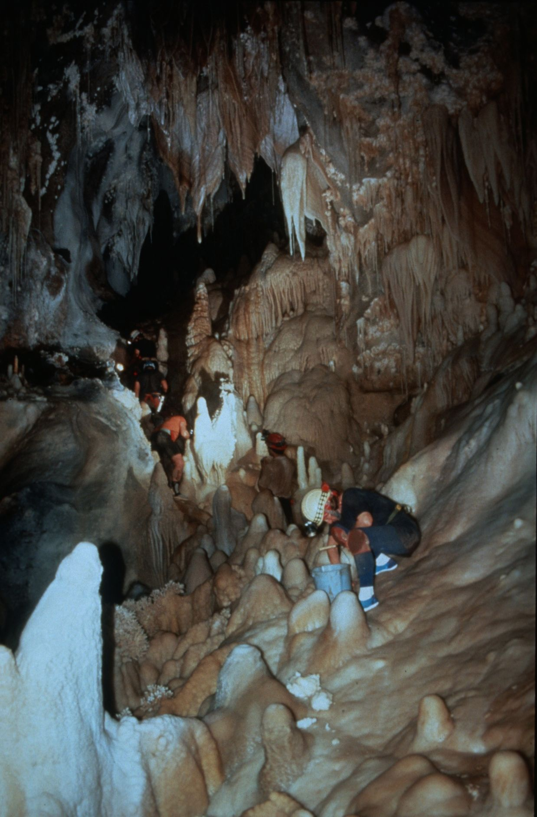
Notes:
Restoration in Progress – Robert Montgomery

Slide 45
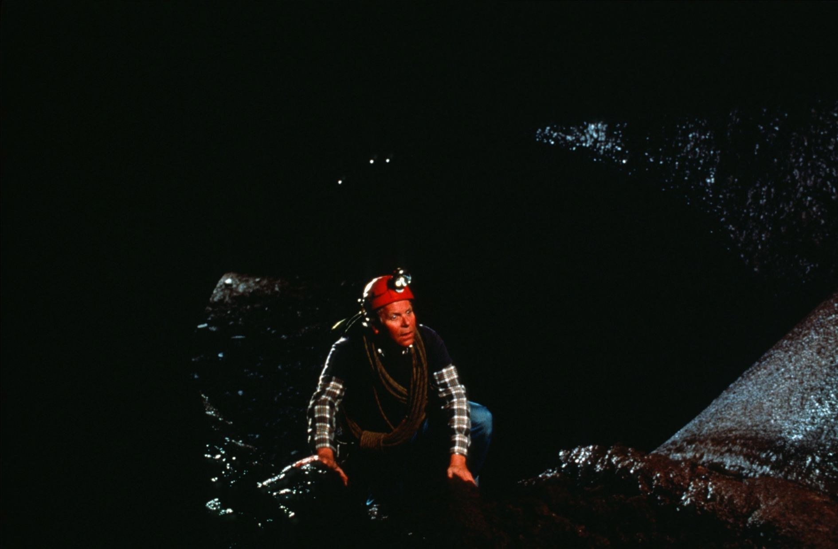
Notes:
Vertical Tubin’- Dave Bunnell

Slide 46
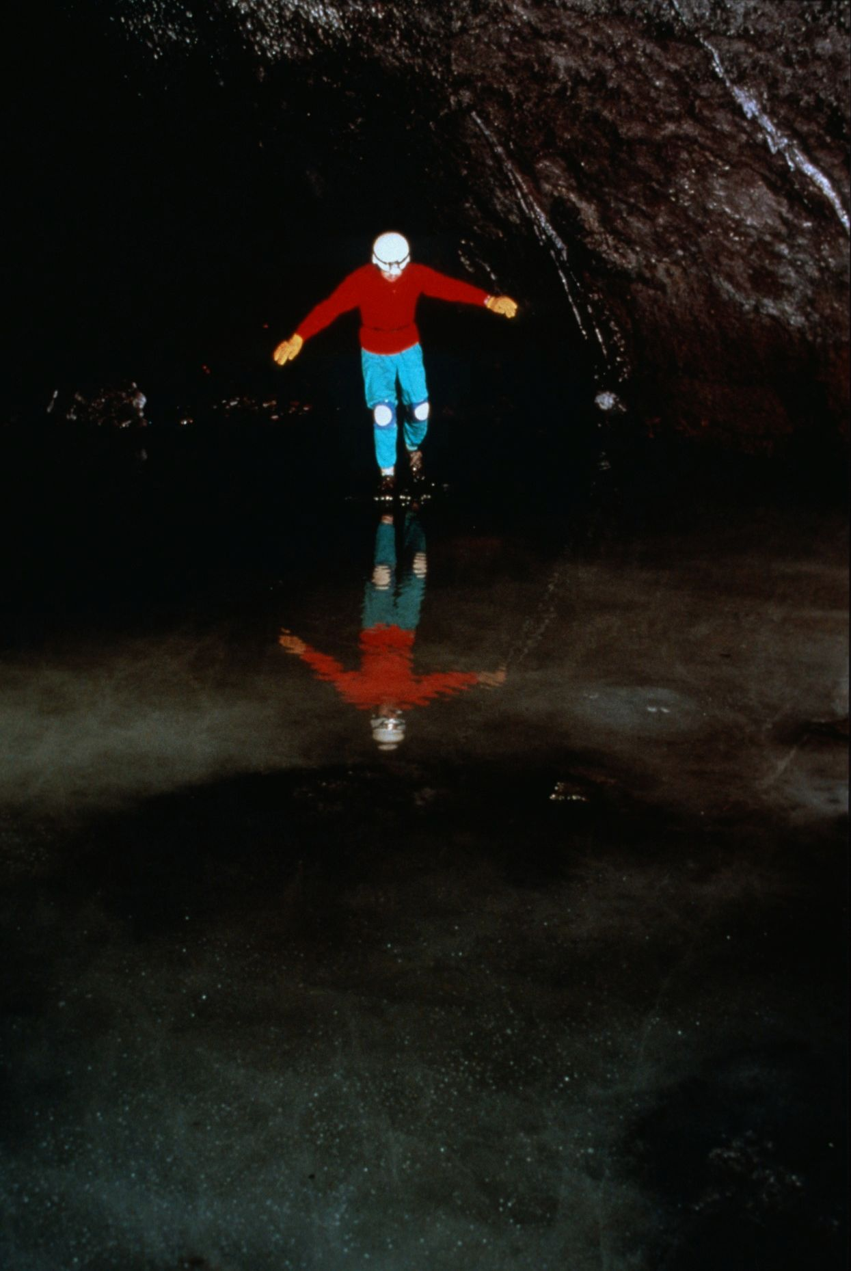
Notes:
Spelean Skating – Peter and Ann Bosted

Slide 47
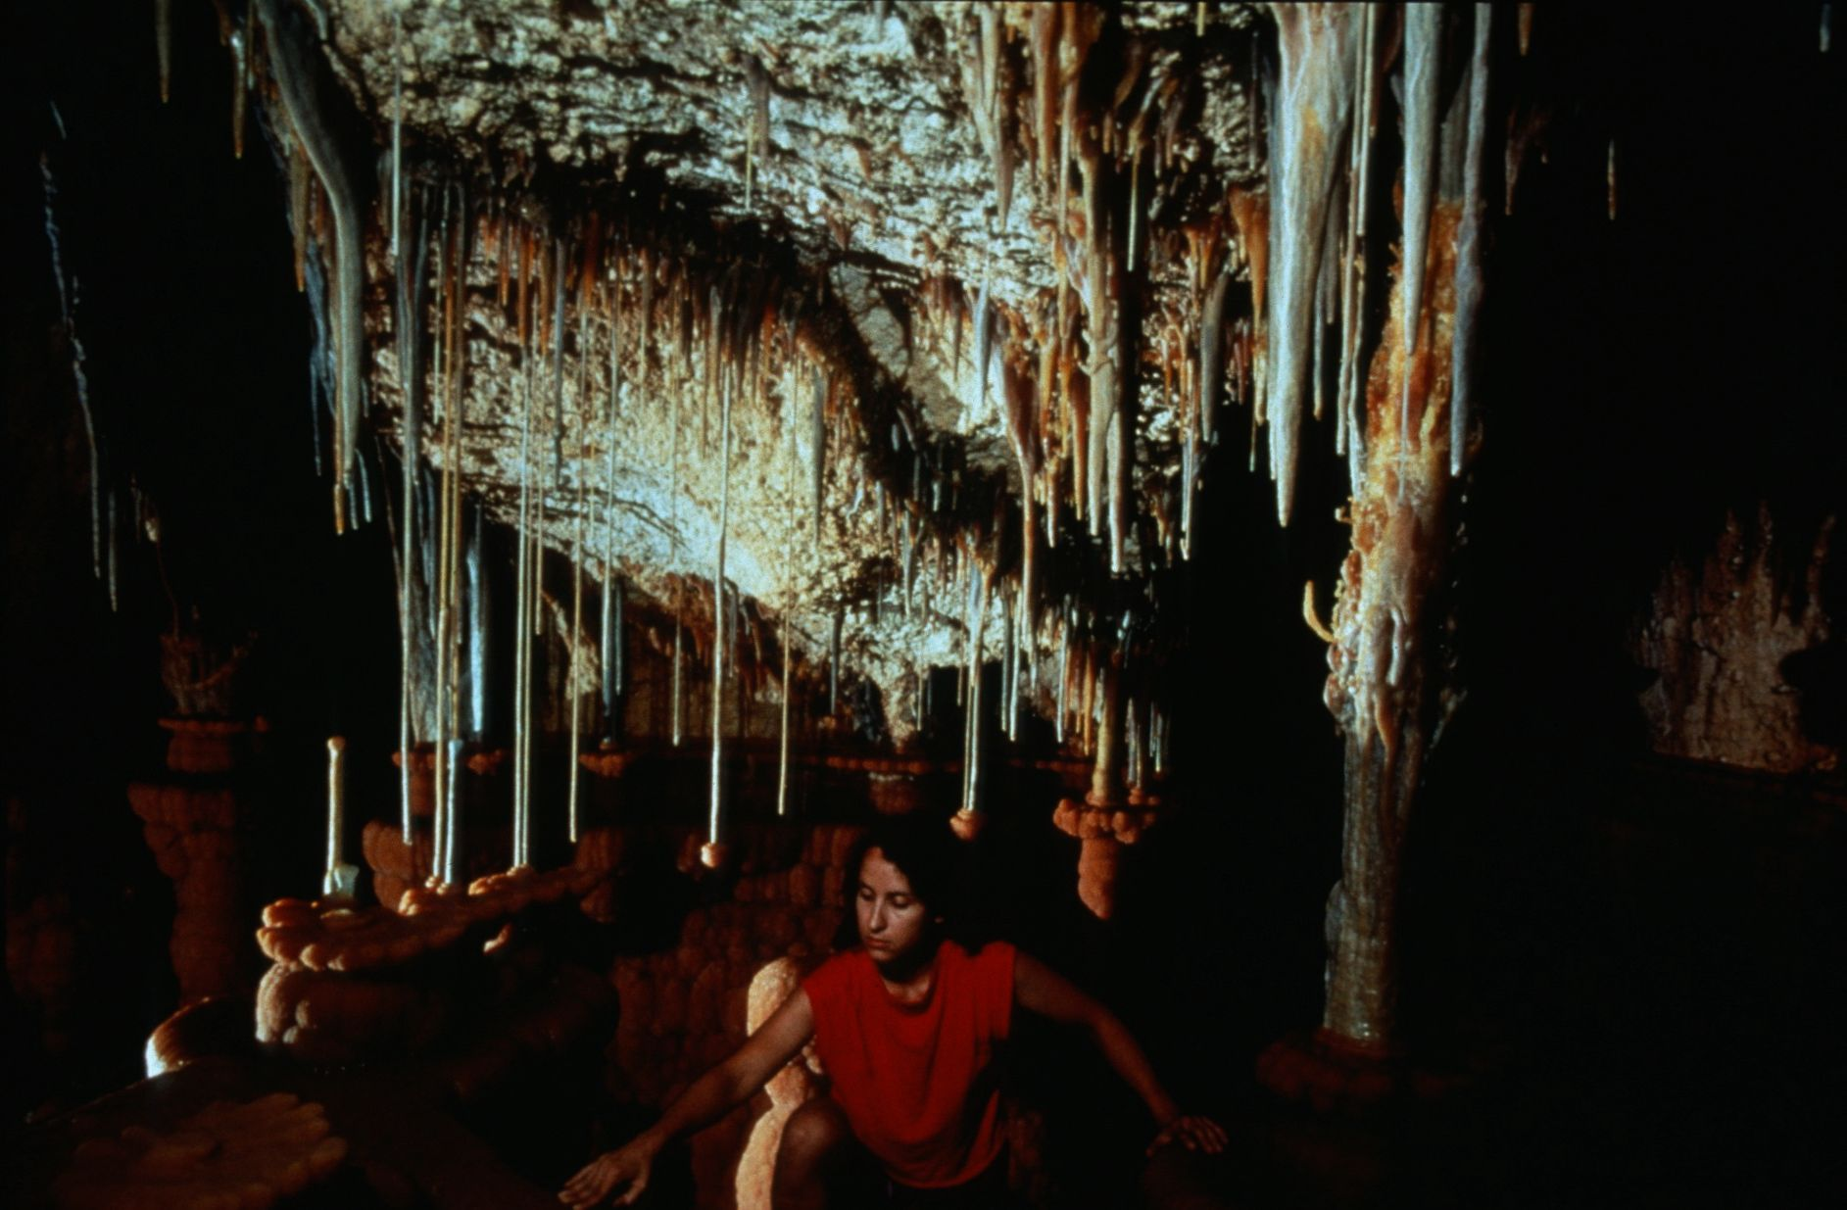
Notes:
Caving Clean – Dave Bunnell

Slide 48
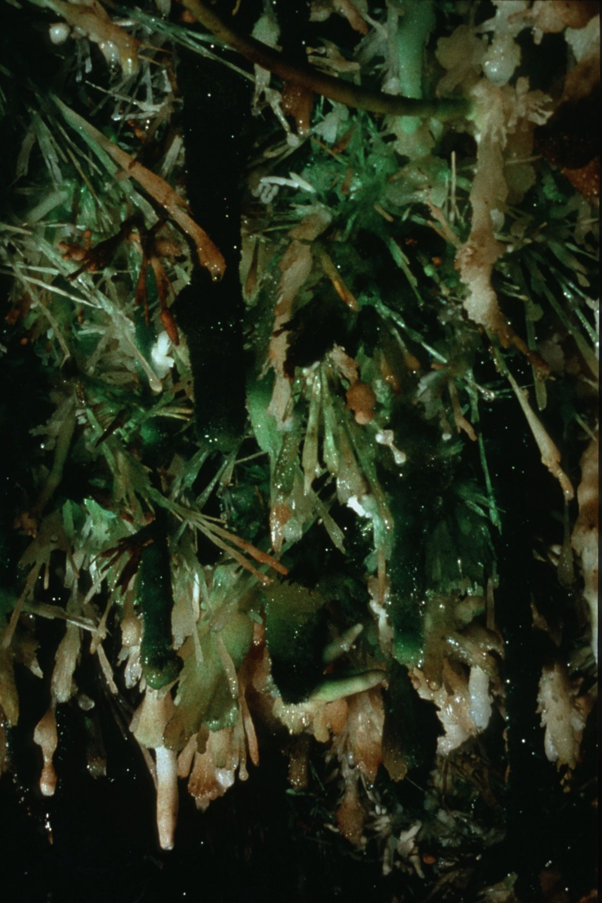
Notes:
Caving in the Teeth of Spar – Peter and Ann Bosted

Slide 49
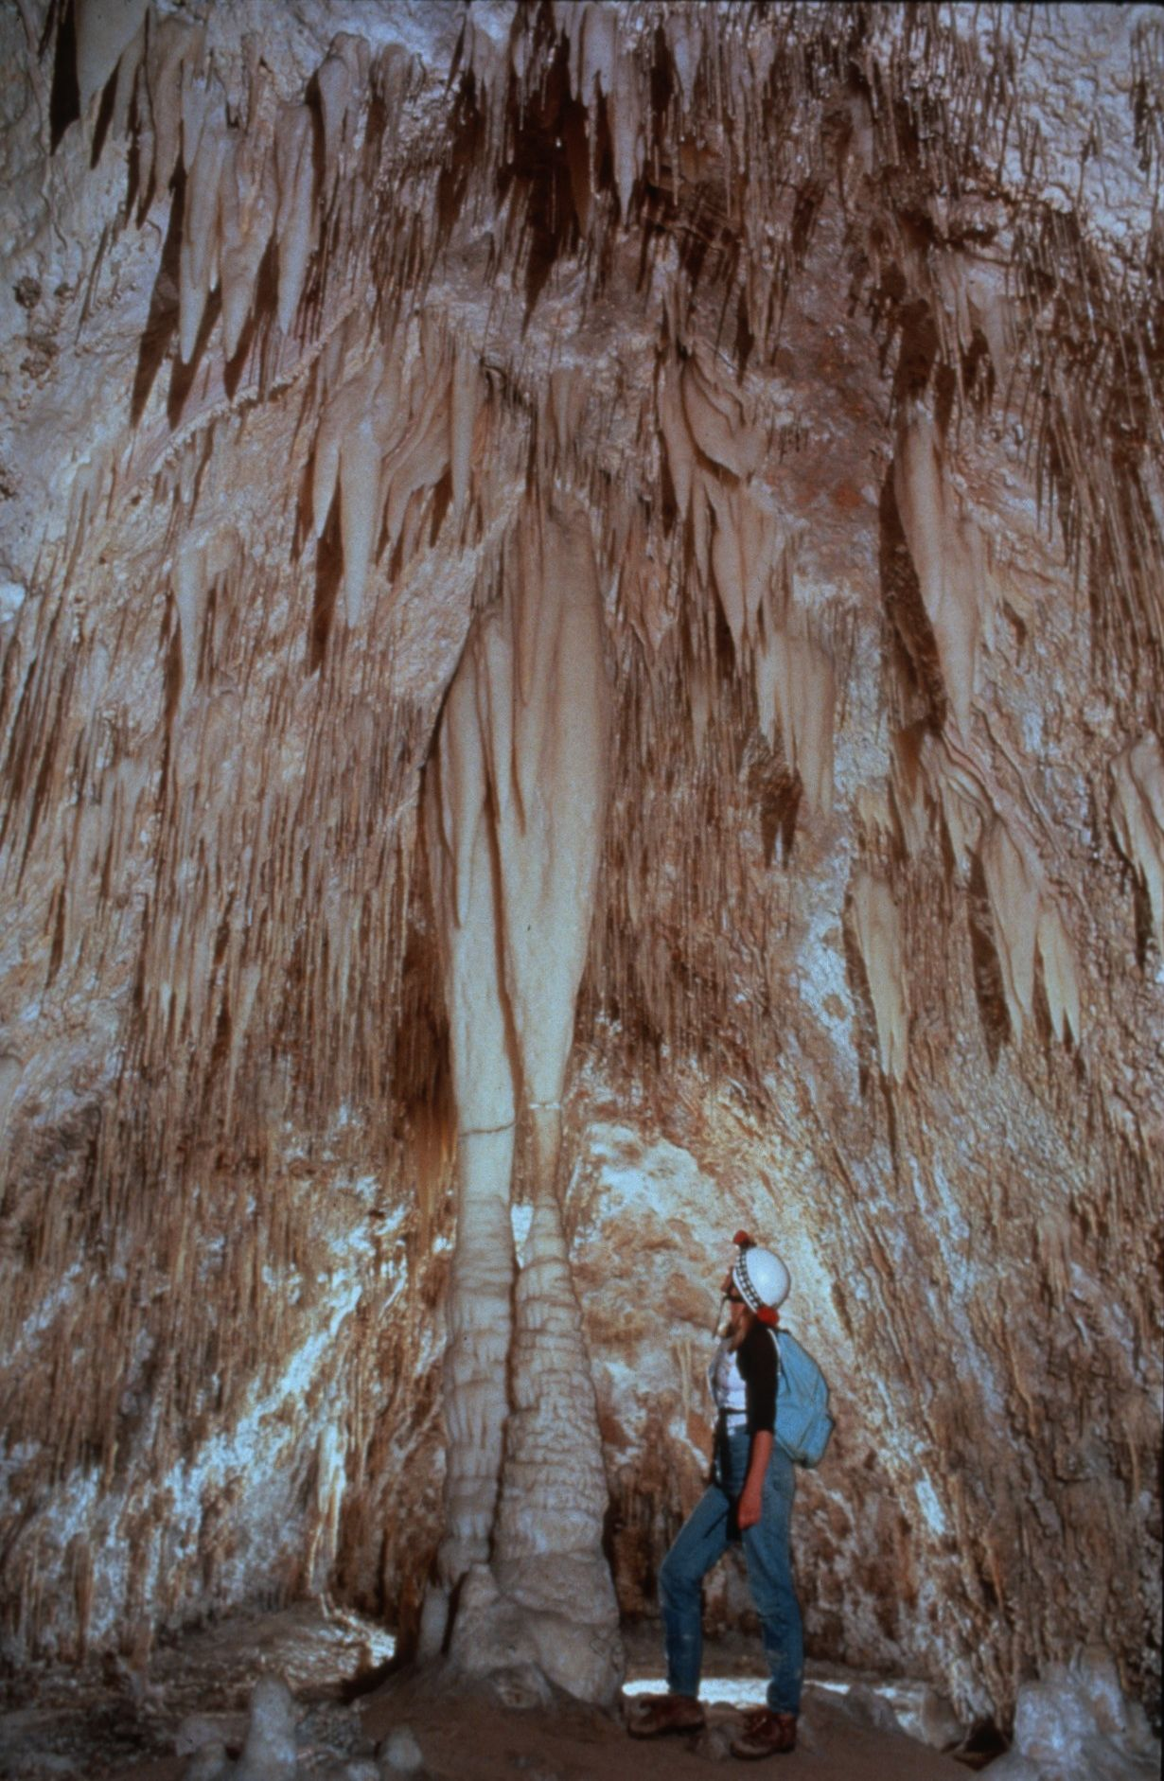
Notes:
Colonel Bowles Room – Dave Bunnell

Slide 50

HONORABLE MENTION
PHOTO SALON
Notes:
Entries Which Received Honorable Mention – Green Ribbons

Slide 51
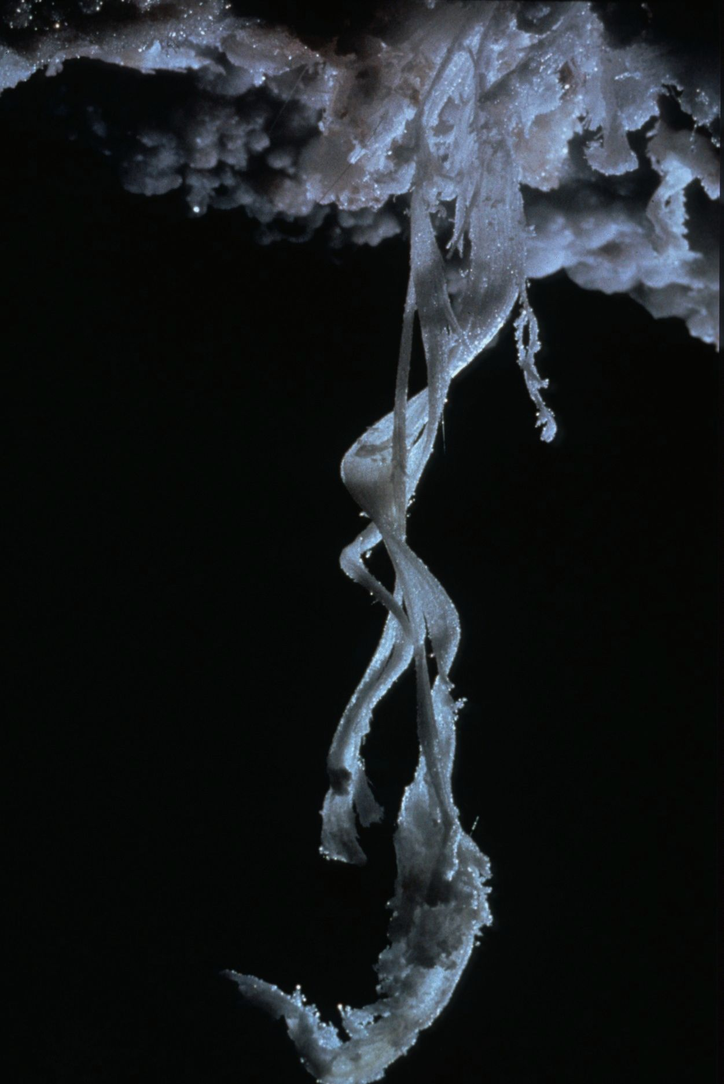
Notes:
Twisted Crystals – Peter and Ann Bosted

Slide 52
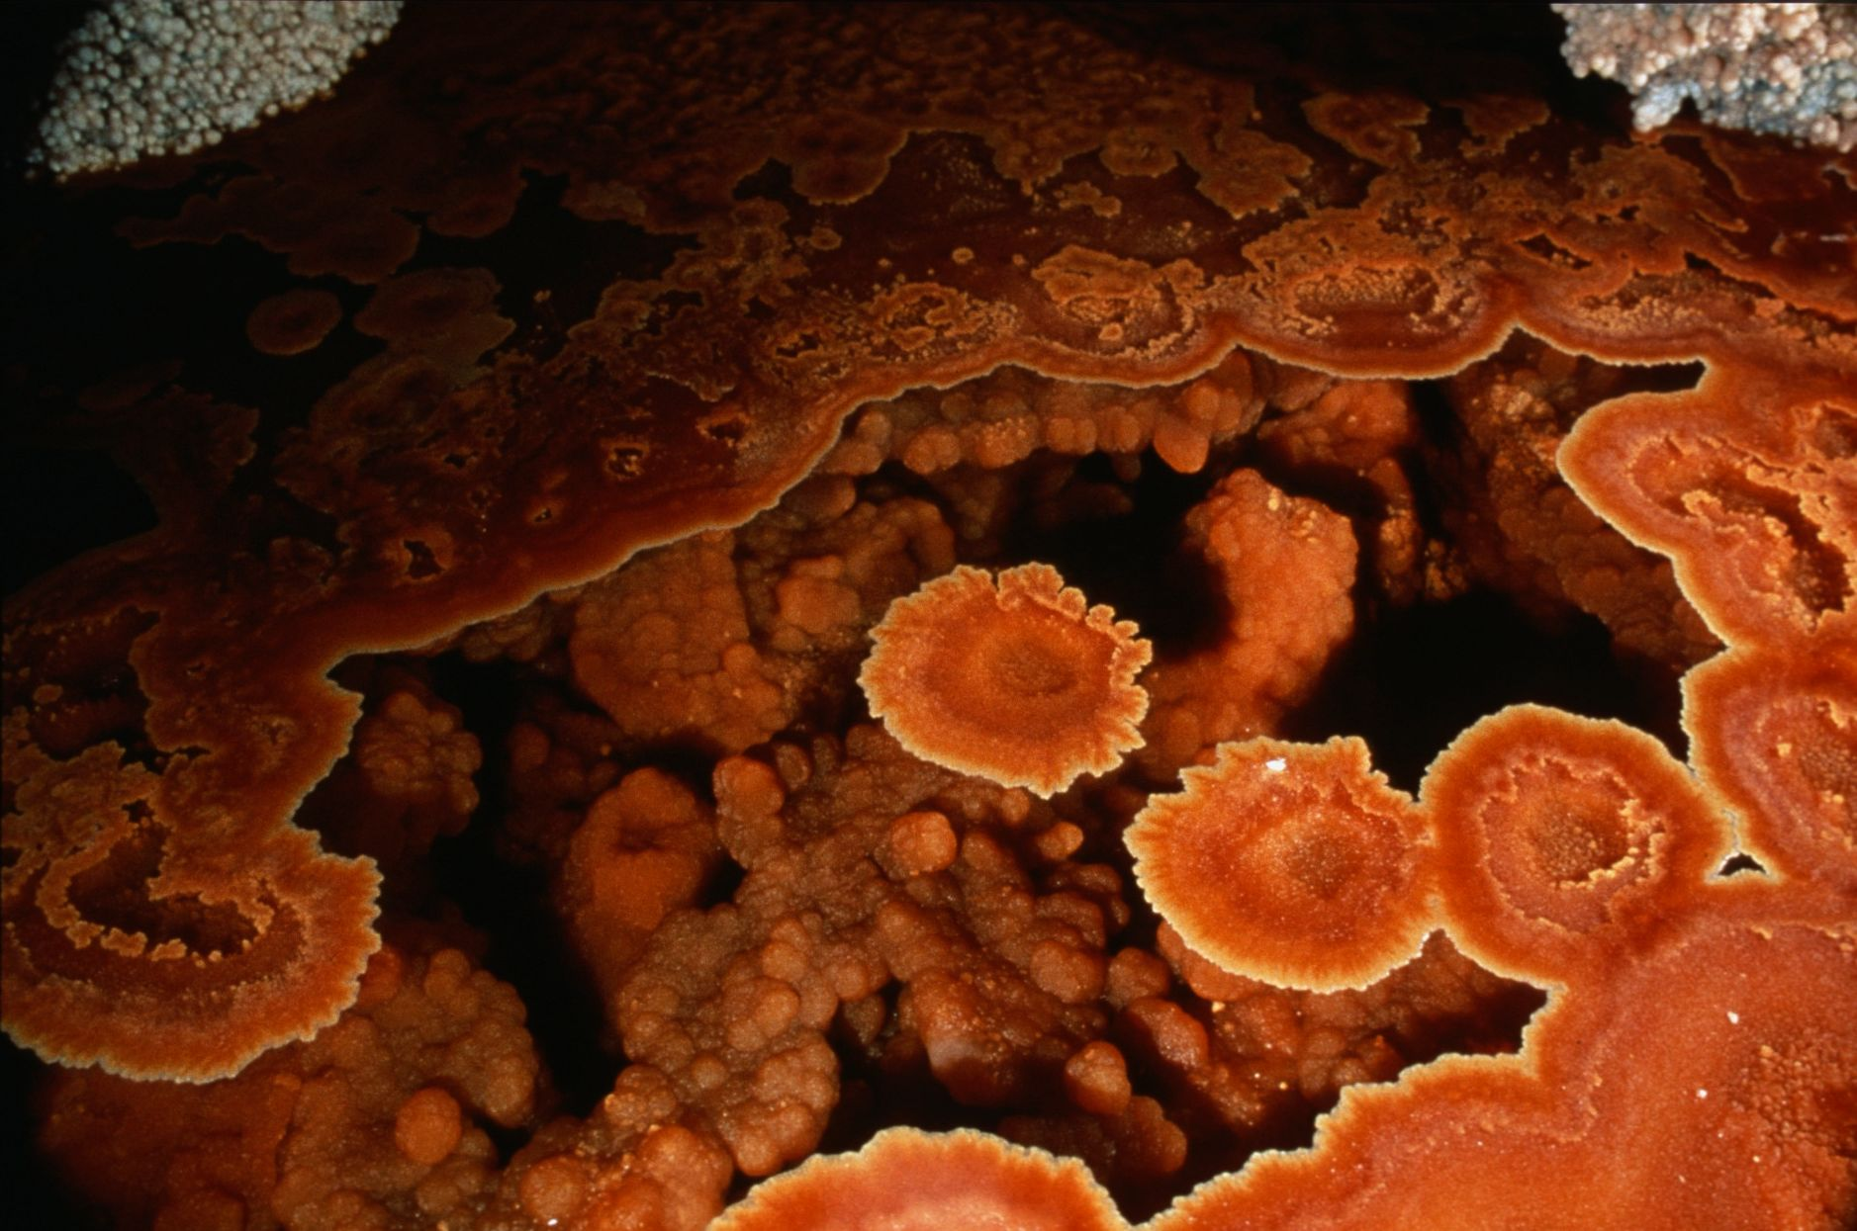
Notes:
Orange Lilies – Dave Bunnell and Djuna Bewley

Slide 53

Notes:
At “Lake of the Clouds”- Peter and Ann Bosted

Slide 54

Notes:
The Madonna – Ed McCarthy and Carl Samples

Slide 55

Notes:
Aragonite ‘tite – Peter and Ann Bosted

Slide 56

Notes:
Shower of Stone – Dave Bunnell and Djuna Bewley

Slide 57

Notes:
Among the Towers – Peter and Ann Bosted

Slide 58

Notes:
Tower of Power – Ed McCarthy and Carl Samples

Slide 59

Notes:
A Gypsum Curl – Peter and Ann Bosted

Slide 60

Notes:
Profusion – John Langevin

Slide 61

Notes:
Crowning Glory – Peter and Ann Bosted

Slide 62

Notes:
Crab’s First Light – Dave Bunnell

Slide 63

Notes:
At the Waterline – Peter and Ann Bosted

Slide 64

Notes:
The Eye of the Tiger – Ed McCarthy and Carl Samples

Slide 65

Notes:
Frozen in Time – Dave Bunnell

Slide 66

Notes:
On Rope. Off Boots – Peter and Ann Bosted

Slide 67

Notes:
A Walk Under the Park – David Harris

Slide 68

MERIT AWARD
PHOTO SALON
Notes:
Entries Which Received Merit Award – Blue Ribbons

Slide 69

Notes:
Beside the Point – Peter and Ann Bosted

Slide 70

Notes:
Redwall Silhouette – Dave Bunnell

Slide 71

Notes:
Climbing System… - Richard Vernier

Slide 72

Notes:
… Still Going and Going and Going… - Richard Vernier

Slide 73

Notes:
Ghostly Gallery – Dave Bunnell

Slide 74

Notes:
Underwater Growth – Peter and Ann Bosted

Slide 75

Notes:
The Only Way to Go – David Harris

Slide 76

Notes:
Fantasy – Peter and Ann Bosted

Slide 77
BEST OF SHOW
PHOTO SALON
Notes:
Entry Selected As Best of Show – Medal

Slide 78

Notes:
Cave Leaf in Atlantis – David Harris

Slide 79
Photographers

Slide 80
Photographers:
  Djuna Bewley
  Peter and Ann Bosted
  Dave Bunnell
  Collin Gatland
  David Harris
  Jay Jordan
  John Langevin
  Ed McCarthy & Carl Samples
  Robert Montgomery
  John Van Swearingen, IV
  Richard Vernier

Slide 81

An NSS Audio-Visual Library Presentation
The Best of the
1994 NSS Photo Salon
Original slide program S917
Slides digitized by David Caudle
PowerPoint program created by Jim McConkey
81 slides, with script in presenter notes
PowerPoint created 3/08/2021
National Speleological Society
6001 Pulaski Pike
Huntsville, AL 35810-1122
256- 852-1300
nss@caves.org
https://caves.org/

